Slide 1
Creating a sense of belonging on campus: our shared responsibility
Richard Q. Shin, Ph.D.
Dickinson College
Friday, September 16th 2016

Slide 2
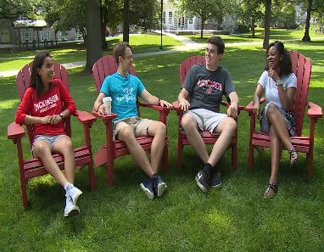
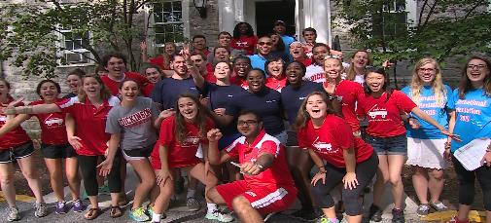
Defining a sense of belonging
Caring
Supportive
Welcoming
Connected
Safety
Community
Unity
Appreciated

Slide 3
Importance of sense of belonging
Sense of belonging critical to success of college students (O’keefe, 2013)
Particularly important for retention of students considered “at risk” for non-completion
Students feeling cared for also related to their ability to perform at their best (Heisserer & Parette, 2002)
Sense of connectedness, or lack thereof, decisive factor in withdrawal of students from underrepresented groups (McLean et al., 1999)

Slide 4
Marginalized students
Groups with higher proportions of students who feel disconnected, rejected, and like they don’t belong include (Heisserer & Parette, 2002; Stevenson, 2010):
Student of color
LGBTQ students
Students from poor or working class backgrounds
First generation students
Students with (dis)abilities
International students
Students with mental illness

Slide 5
Dickinson College Demographics
Faculty racial diversity
88% white
12% underrepresented groups
Student racial diversity
83% white
17% underrepresented groups: 6.1% Latinx, 4.4% African American, 3.5% Multiracial, 2.9% Asian American, 0.08% Native American
90.5% domestic students and 9.5% are international

Slide 6
Predominantly White Campuses
Challenges (Hurtado et al., 1998)
PWIs provide limited opportunities for interactions across race/ethnicity barriers
Constrains student and faculty learning about socially and culturally diverse groups
Diverse students viewed as “tokens,” which leads to exaggeration of group difference and distortions based on societal stereotypes
Can increase social stigma felt by racially/ethnically diverse students and produce minority status stress

Slide 7
“No matter how outstanding the academic institution, ethnic minority students can feel alienated if their ethnic representation on campus is small” (Loo & Rolison, 1986, p. 72)

Slide 8
LGBTQ Students
Whether on campus or in the community, LGBT individuals experience violence, verbal harassments, threats and subtle forms of discrimination (e.g., D’Augelli, 1992; Smith & Shin, 2014; Vaccaro, 2012)
LGBT college students regularly hear offensive comments and experience unfair treatment (Gortmaker & Brown, 2006)
Even when LGBT students do not experience overt acts of aggression, many find campus climates to be unwelcoming, invalidating, or unsupportive (Rankin et al., 2010), which has been found to be especially true for transgender students who often feel invisible (Bilodeau, 2009)

Slide 9
Barriers to sense of belonging
Various macro and micro level factors found to be associated with students’ sense of belonging on campus (e.g., Hurtado et al., 1998; O’Keefe, 2013)
Historical legacy of inclusion or exclusion
Current policies and practices regarding diversity
Campus climate
Structural diversity
Friendliness and accessibility of staff and faculty

Slide 10
Intersectionality (Crenshaw, 1989; Shields, 2008)
Every person in our society has multiple social identities
Most individuals have BOTH privileged and oppressed social identities
Helps make sense of how interlocking systems of oppression are experienced by marginalized groups (Syed, 2010)
Class
Race
Gender
Ability
Sexuality
Religion

Slide 11
Words Matter: Racial Microaggressions
Racial microaggressions refer to “brief and commonplace daily verbal, behavioral, and environmental indignities, whether intentional or unintentional, that communicate hostile, derogatory, or negative racial slights or insults to the target person or the group (Sue, Capodilupo et al., 2007, p. 273)
Microinsults are rude or insensitive behaviors or statements that degrade a person’s racial heritage or identity.
Microinvalidations occur when a person negates or denies the thoughts, feelings, or experiences of a person of color

Slide 12
Sexual Orientation Microaggressions (Platt & Lenzen, 2013)
Oversexualization
Immediately associating sexual orientation with sexual acts
Homophobia
Assumption that homophobia is contagious
Heterosexist language/terminology
Words/phrases that associate gay identity with something negative
Sinfulness
Belief that any non-heterosexual orientation is morally deviant and wrong

Slide 13
Sexual Orientation Microaggressions (cont.)
Assumption of abnormality
Belief that any non-heterosexual identity originates from psychological pathology
Denial of individual heterosexism
Refusal to believe that one holds any biases or negative attitudes toward LGBTQ individuals
Endorsement of heteronormative culture and behaviors
Acceptance of heterosexual standards and norms, which exclude sexual minorities

Slide 14
Consequences of Microaggressions
More dangerous and insidious than overt forms of discrimination
Cumulative effects have been associated with (Kim et al., 2016; Nadal et al., 2014):
Mistrust
Hopelessness
Hypertension
Depression
Anxiety
Poor educational performance

Slide 15
Racial Bias
Traditional racism, such as White supremacy and Jim Crow (Bonilla-Silva et al., 2004) are no longer socially acceptable (Dovidio, 2001)
Although self-reported prejudice has reduced dramatically in the past 60 years, discrimination evidence has not decreased accordingly (Dovidio et al., 1996)
Egalitarianism has become a central, salient value of U.S. culture

Slide 16
Implicit Bias
Although overt expressions of prejudice have decreased, internally safeguarded biases clearly persist
In contrast to conscious and overt racist attitudes, this form of bias is implicit and driven by automatic, subconscious prejudicial associations (Cooper et al., 2012; Katz & Hoyt, 2014)
Implicit bias unknowingly held by beneficent, egalitarian health and mental health professionals (e.g., Boysen, 2010; Chapman et al., 2013)

Slide 17
Implicit Bias & Mental Health Disparities
Extensive, pervasive, and persistent inequitable patterns of mental health service delivery between Whites and African Americans (Flores, 2010)
Sorry, I’m not accepting new patients (Kugelmass, 2016)
Voice actors left phone messages for 320 New York city based psychotherapists
Offer rates varied by race--therapists offered appointments to 28 percent of white middle-class callers but only 17 percent of black middle-class ones
Is Allison more likely than Lakisha to receive a callback from counseling professionals: A racism audit study (Shin et al., in press)
Voice actors left phone messages for 317 counselors and psychologists in Maryland
“Allison” received appointment offers 63 percent of the time, while “Lakisha” received them only 51 percent of the time

Slide 18
Implicit Bias & Health Disparities
As opposed to explanations that focus on patients’ genetic/biological predispositions and socioeconomic predictors, a growing body of research pointing to health provider implicit bias (e.g., Kressin & Petersen, 2001; Paradies et al., 2013; Shin et al., in press)
African American patients perceived in more negative terms than White patients
Significant differences observed in the way White doctors communicate with patients of color, the kind of treatment they recommended and the degree to which they coordinate care regimens with their patients (Wise, 2010)
Significant differences observed in offers for counseling services for prospective clients with Black sounding versus White sounding name (Shin et al., in press)

Slide 19
Reducing Bias and Microaggressive Interactions: AAA
Acknowledgment
-Accept the fact that each of us are affected by cultural socialization, therefore, we are all susceptible to perpetrating microaggressions
Awareness
-Maintain a high level of awareness of internalized biases and how they affect interactions from members of marginalized groups
Action
-Commit to increasing cultural competence through continual self-examination, exposure to other cultural norms and histories, and meaningful interpersonal relationships

Slide 20
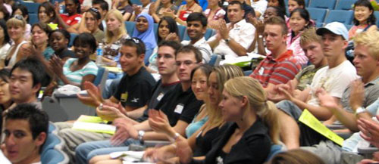
Questions?
Thank you!!!

