Slide 1
ADMINISTRATOR AND STAFF SALARY ASSESSMENT AND PROGRAM DESIGN
Dickinson College
Position Description Training
March 17-18 2015

Slide 2
Today’s Agenda
Present project overview and estimated timing, and project team members
Discuss the importance of position descriptions in salary assessment study
Review position description questionnaire (PDQ) in detail
Breakout into table groups to develop essential functions for example position
Address additional comments and answer remaining questions
At this time, we are asking that position descriptions be completed for Administrator positions. Support staff position descriptions will be updated in Summer 2015.

Slide 3
Overview of Project Work Steps and Estimated Timing
Phases and Work Steps | Estimated Timing
Total Compensation Philosophy/Strategy Development Leadership interviews and President’s Staff meeting Compensation philosophy guiding principles Continued revisions to philosophy | January – March
Position Description Update Revised position description template Conduct position description training sessions Position description update Position description review for consistency; finalization and approval | March – June
Market Assessment of Administrative Positions Survey source identification Matching of Dickinson benchmark positions to the market Market assessment of benchmark positions to determine competitiveness HR and VP review of market matches | June – July
Salary Program Review, Development, and Refinement Salary structure development (admin positions) or refinement (support staff positions), and assignment of positions to the structure Employee and cost implications HR and VP review and finalization of salary structure Pay guidelines for managing compensation under structure | August – October
Implementation Planning Implementation strategy and potential alternatives Review proposed recommendations | October – December
1
2
3
4
5

Slide 4
Project Team Members
Dickinson College
Brontè Jones, Vice President for Finance and Administration
Steve Riccio, Associate Vice President of Human Resource Services
Arlene Bones, Director of Human Resource Services
Dennette Moul, Organizational Development & Training Specialist
Michelle Spencer, HRIS Administrator
Connie McNamara, Executive Director, Marketing and Communications
Korey Paul, Senior Research Analyst
Sibson Consulting
Norm Jacobson, Senior Vice President
Michael O’Malley, Senior Vice President
Carolyn Wong, Senior Consultant

Slide 5
Why are accurate position descriptions important?
Benchmarking
Assists in determining the competitive wage/salary for the position
Grade Assignment
Ensures positions are assigned to the appropriate salary grades
FLSA Classification
Ensures appropriate classification under the Fair Labor Standards Act
Internal Equity
Assists in assuring similar salary opportunities for similar positions within the College
Performance Discussions
Ensures that staff and managers have a clear, shared understanding of the position’s major responsibilities, and are able to clarify position expectations and performance standards
Recruiting and Promotion
Ensures that position postings accurately reflect the position’s major responsibilities; helps identify the most appropriately qualified candidates; and provides new incumbents with a clear understanding of the position

Slide 6
Why a Position Description Questionnaire (PDQ)?
The PDQ was developed in a format that:
Is relatively easy to complete for non-HR professionals
Is not highly dependent on individual writing styles
Collects the same type of information for all positions in a clear, consistent format
Can be used on an ongoing basis when positions change significantly and revisions to position descriptions are necessary
HR Services and Sibson worked together to capture all information needed to support the upcoming salary study and salary program development.
The PDQ blends questions with structured answers and opportunities for open-ended narratives.

Slide 7
PDQ Completion Timeframe
Employees Complete PDQ
(Mid March – Early April)
Managers/ Supervisors Review/ Revise PDQs (Mid – Late April)
Sibson Reviews/ Revises PDQs (Late April – Mid May)
HR Services and VPs Finalize and Approve PDQs
(May - June)
Each employee will complete all sections of the PDQ for their position by April 9, 2015
Each manager/ supervisor will review the PDQs for their area, and revise information as needed
Each manager/supervisor will ensure all sections of the PDQs are accurate and complete by April 23, 2015
Sibson will review all PDQs for consistency and appropriateness and provide HR Services with their observations
Sibson to provide feedback on PDQs by May 18, 2015
HR Services and VPs will finalize and approve PDQs in June
HR Services will follow up with the supervisor for clarification or any questions. Once the process has been completed, final descriptions and analysis will be sent to supervisors with communication/ outcomes to employees to follow

Slide 8
Some Additional Questions You Might Have
Will titles change?
Not necessarily
Some titles may be modified to ensure consistency across Dickinson or to make the title more descriptive of actual position accountabilities
Will everyone be writing a new position description?
At this time, PDQs will be completed for all administrative positions. Support staff position descriptions will be updated over Summer 2015
Any recently written position descriptions should be transferred to this new template
Who should complete the PDQ?
Employees should complete the draft of the PDQ based on how the position is intended to function (e.g., responsibilities, requirements)
Managers/supervisors will review the draft PDQ for accuracy and completeness

Slide 9
Some Additional Questions You Might Have continued
How should supervisors address differences between their understanding of a position and the incumbent’s understanding?
Supervisors should hold a conversation with incumbents to clarify the intent of the role and discuss what can be done to ensure the incumbent is able to perform the role as intended
When are completed descriptions due?
Administrator position descriptions should be completed and submitted by managers/supervisors by April 23, 2015
Position descriptions (in the new format) will be finalized and approved in June

Slide 10
Important Considerations in Completing Your PDQ
Descriptions are viewed as a whole. When positions are reviewed for compensation and classification purposes, descriptions will be reviewed in their entirety. There are no points or other values associated with the contents of each specific PDQ section
Describe the position, not the person. The PDQ should accurately represent the intended position (i.e., what the position should be doing). Do not include possible future position changes or outdated functions that are no longer part of the role
Supervisors should review the PDQ and modify it to show what the position is intended to do
Supervisors and incumbents should hold a conversation to discuss any major differences in understanding of the position and what can be done to address differences
Be as specific as possible. Some multiple choice sections request or require additional descriptions or examples to help clarify responsibilities, position components and other pertinent, related information such as unusual work circumstances, cyclicality or periods of high volume
Refer to others by title. Use position titles or roles when referring to others at Dickinson
Be clear and concise. Avoid jargon, spell out acronyms, and explain technical terms where necessary/appropriate

Slide 11
What to Include and Not Include?
Include |  | Do Not Include
Essential and regularly required responsibilities |  | One time, short-term assignments
Expected outcomes and behaviors |  | Exhaustive list of tasks, and/or details on “how” work is done
Normal expectations of a fully competent person, meeting all position requirements |  | Tasks or expectations designed around an individual (e.g., performance, professional interests, etc.)
Clear, accurate descriptions |  | Flowery language, acronyms without explanation, misleading or vague descriptions
For example, instead of writing...
“Enters the following information into system screens ABC and XYZ: Student Name, Address, GPA…”
You would write…
“Enters required data into Banner module and audits entries for completeness and accuracy.”

Slide 12
PDQ Section Detail

Slide 13
Position Description Questionnaire Sections
Introduction/Demographics
Position Summary
Essential Functions
Supervisory Responsibilities
Education
Work Experience
Independence of Action
Physical/Environmental Demands
Additional Information

Slide 14
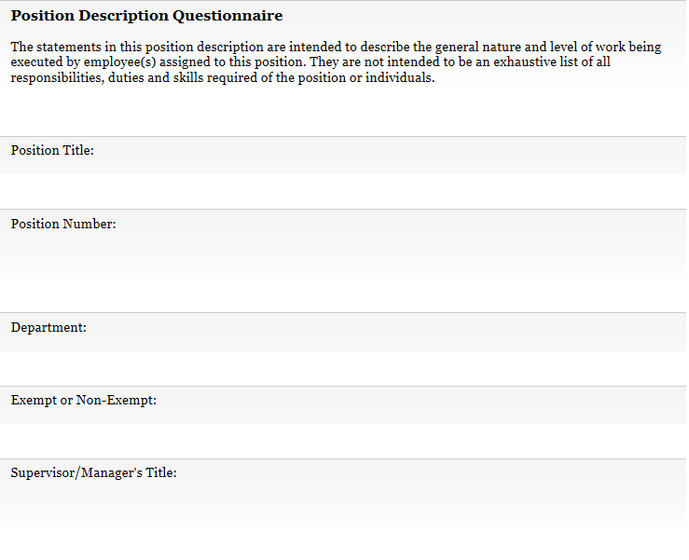
Introduction/Demographics
The following information will be automatically entered by the system:

Slide 15
Position Summary
This is a brief summary of the position’s critical responsibilities
Meant to describe the general purpose of the position at Dickinson
Think of this as the “elevator summary”
You meet an old friend in an elevator. How would you describe your position in such a brief time?
Sometimes this is easier to draft after you’ve finished the rest of the PDQ
Examples
Human Resource Manager: Under the general direction of the Director, in a team-centered environment, this position serves as a resource for and provides assistance to College staff and faculty regarding all human resource programs, policies and procedures.
Campus Security Officer: Under direction from a shift supervisor, provides security, safety and community services to College employees, students and visitors. Major responsibilities include patrolling College property on foot, monitoring building security, and responding to and documenting campus incidents, including emergency situations.

Slide 16
Essential Functions
This is the most important part of the PDQ, as it truly gets to the heart of what the position “does”
These are the major ongoing responsibilities/outcomes that you are expected to achieve in your role
Use the Responsibilities Worksheet to help develop Responsibility Statements
Describe up to 8 essential functions (not tasks) the position must achieve
Write statements so someone unfamiliar with the role can understand what the position does
Include the approximate percentage of time spent on each function over the course of a year
Include any responsibilities that require 10% or more of the position’s time
Note that the total should reach 100%

Slide 17
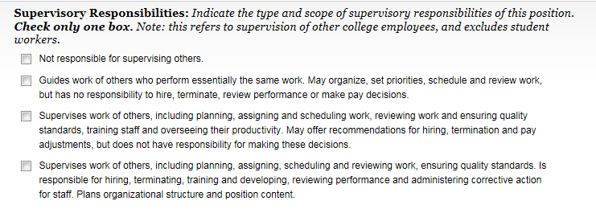
Supervisory Responsibilities
If the position does not have supervisory responsibilities, check the first box
Otherwise, check the box that best describes the type of supervisory responsibilities performed by the position

Slide 18
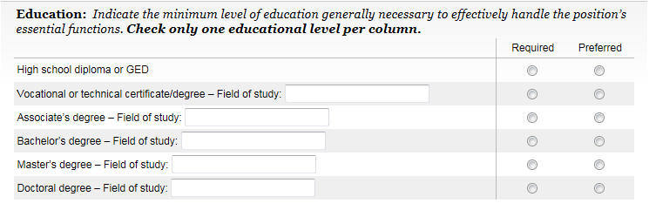
Education (Preferred and Required)
Indicate the minimum level of education required and preferred, as well as the field of study for the position. Note: requirements and preferences for the position may be different than the current incumbent’s education
If experience can substitute for education, check the designated box and describe in the space provided
For example: “Bachelor’s degree, plus one year’s related experience, OR High school diploma plus four years related experience”
Provide additional information as needed (e.g., licensures, certifications, etc.)

Slide 19
Work Experience (Minimum)
Check the box that best describes both the minimum work experience required to be hired into the position
Requirements for the position may be different than the current incumbent’s work experience

Slide 20
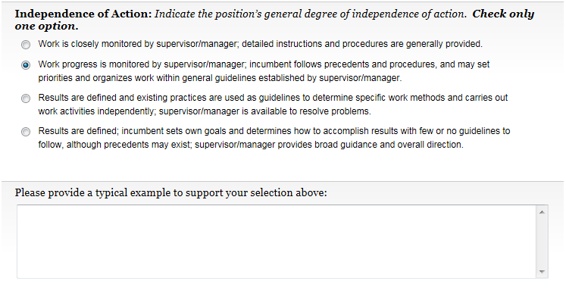
Independence of Action
Indicate the level of independence this position has in conducting work
Check only one box
Provide a typical example to support your selection

Slide 21
Physical/Environmental Demands
For office-based positions with no physical/environmental demands, check the box that states “Office environment/no specific or unusual physical or environmental demands.”
For other positions, check the statement box indicating specific physical requirements or environmental exposures. A page with more detailed information on physical requirements and the work environment will then be displayed

Slide 22
Additional Information
Please describe as clearly and concisely as possible any additional information that would be important to fully understand the role, responsibilities, nature, and scope of the position
Examples of additional information include: unusual circumstances, cyclicality, or anything else to help the reader understand the position better

Slide 23
Essential Functions Exercise

Slide 24
Describing Essential Functions Clearly
Describing responsibilities clearly eliminates ambiguity and misinterpretation when the position is being analyzed
This is the heart of the PDQ as it outlines what the position is ultimately accountable for—what, how, and why
Example
These were Essential Function statements of a position description at another institution
What do the phrases mean to you?
Inventory control
Prepare course materials
Liaison with other departments

Slide 25
Describing Essential Functions Clearly continued
Use the following pattern to write a Responsibility Statement:
Action Word
+
Subject
+
Activities
For example:
Coordinate travel arrangements by preparing itineraries and booking flights
Action Word
Subject
Activities

Slide 26
Describing Essential Functions Clearly continued
EXAMPLES
Maintain audio-visual equipment inventory by:
Tracking borrowed equipment
Entering new equipment into the equipment log
Ensuring the accuracy of the equipment database
Provide technical IT support to the organization by:
Responding to telephone calls, email, and personnel requests for technical help
Troubleshooting user computer problems by documenting, tracking, and monitoring the problem to ensure a timely resolution
Prepare monthly financial reports by:
Collecting and verifying financial data
Entering current data into spreadsheets
Running analysis reports
Consolidating final figures into standard monthly financial reports
Identify funding opportunities for the institution by:
Cultivating potential new donors from prospect pool of contacts
Attending networking functions including dinners, receptions, and other special events

Slide 27
Developing Responsibility Statements
Use the Responsibilities Worksheet to organize your thoughts
List all activities, duties and tasks you perform in the “Duties and Tasks” column
Cluster related activities together under the “Related Groupings” column
Eliminate duplicates
Clarify language
Delete extraneous statements
Review each grouping to develop a Responsibilities Statement and determine what the position is accountable for
The sample worksheet shows activities for a position called “Administrative Assistant”
This position was selected as an example because the activities are common to many organizations and institutions
This process can be used for any position

Slide 28
Responsibilities Worksheet
Position Title: Administrative Assistant
Duties and Tasks | Related Groupings | Responsibility Statement
Prepare and plan for meetings and conferences Secure space for meetings and conferences Order office supplies Maintain inventory of office supplies Prepare requisitions for special orders of supplies Inform meeting participants of meeting location and time Distribute agendas Track department budget Draft and type correspondence Make travel arrangements Schedule meetings Run reports File paperwork Charge cost of supplies to departments Work with vendors
As you read this list, it is hard to determine what this position is really responsible for

Slide 29
Responsibilities Worksheet continued
Position Title: Administrative Assistant
Duties and Tasks | Related Groupings | Responsibility Statement
Prepare and plan for meetings and conferences Secure space for meetings and conferences Order office supplies Maintain inventory of office supplies Prepare requisitions for special orders of supplies Inform meeting participants of meeting location and time Distribute agendas Track department budget Draft and type correspondence Make travel arrangements Schedule meetings Run reports File paperwork Charge cost of supplies to departments Work with vendors | Prepare and plan for meetings and conferences Secure space for meetings and conferences Inform meeting participants of meeting location and time Distribute agendas Work with vendors Schedule meetings
 | Order office supplies Maintain inventory of office supplies Charge cost of supplies to departments Prepare requisitions for special orders of supplies
 | Track department budget Draft and type correspondence Make travel arrangements Run reports File paperwork

Slide 30
Responsibilities Worksheet continued
Position Title: Administrative Assistant
Duties and Tasks | Related Groupings | Responsibility Statement
Prepare and plan for meetings and conferences Secure space for meetings and conferences Order office supplies Maintain inventory of office supplies Prepare requisitions for special orders of supplies Inform meeting participants of meeting location and time Distribute agendas Track department budget Draft and type correspondence Make travel arrangements Schedule meetings Run reports File paperwork Charge cost of supplies to departments Work with vendors | Prepare and plan for meetings and conferences Secure space for meetings and conferences Inform meeting participants of meeting location and time Distribute agendas Work with vendors Schedule meetings | Coordinate all aspects of meetings and conferences by: Scheduling meetings and conferences and informing participants of location and time Securing space and working with vendors to set up meetings and conferences Sending soft-copy agendas to participants before the meeting and distributing hard copies during the meeting
 | Order office supplies Maintain inventory of office supplies Charge cost of supplies to departments Prepare requisitions for special orders of supplies | Maintain office supplies inventory by: Monitoring supply inventory and replenishing as necessary Preparing requisitions for special orders Charging cost of supplies to appropriate departments
 | Track department budget Draft and type correspondence Make travel arrangements Run reports File paperwork | Perform administrative and secretarial support for the department, including: Tracking department budget and running reports Making travel arrangements Filing Drafting and typing correspondence

Slide 31
Next Steps and Contact Information
Employee to draft initial PDQ by April 9, 2015
Manager/ supervisor to submit draft PDQs by April 23, 2015
Sibson will provide observations to HR Services on changes to position descriptions by May 18, 2015
HR Services and Vice Presidents will finalize and approve the position descriptions in June
If you have any questions as you go through this process, either about your individual position responsibilities or specific questions on completing the PDQ, please send an email to pdq@dickinson.edu.

