Slide 1
Can a computer program think like a human?
John MacCormick
September 29, 2026

Slide 2
Which of these best characterizes your feelings about artificial intelligence?
Things fall apart; the centre cannot hold;
Mere anarchy is loosed upon the world,
The blood-dimmed tide is loosed, and everywhere
The ceremony of innocence is drowned;
The Second Coming
W B Yeats, 1919
Upon the upland road
Ride easy, stranger:
Surrender to the sky
Your heart of anger.
High Country Weather
James K Baxter, 1948

Slide 3
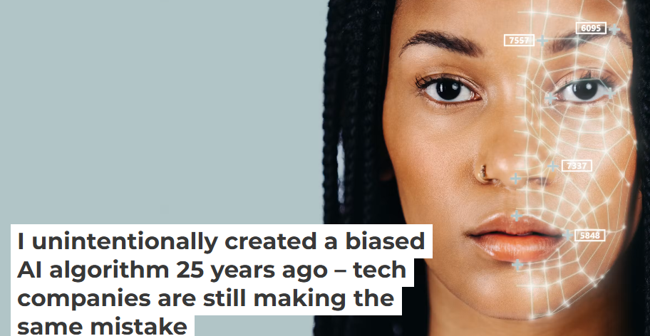
Some things I’m not going to talk about
Bias in AI
jm, The Conversation, May 9, 2023

Slide 4

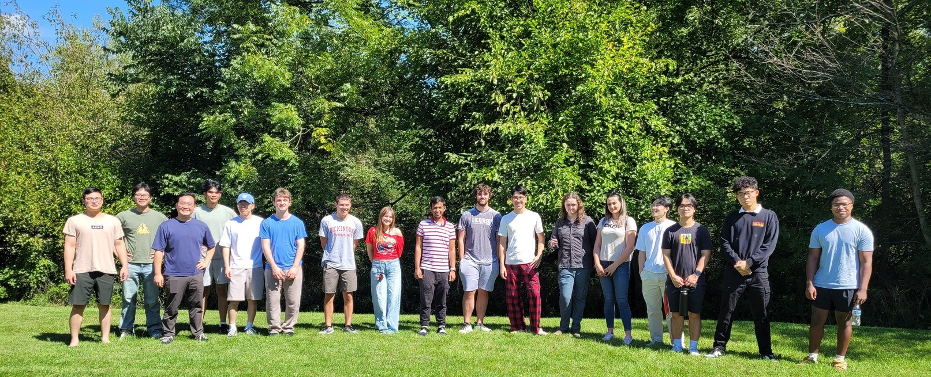

Some things I’m not going to talk about
stopPAX1.com
Bias in AI
Sustainability and AI
PAX-1
paDataCenters.com

Slide 5
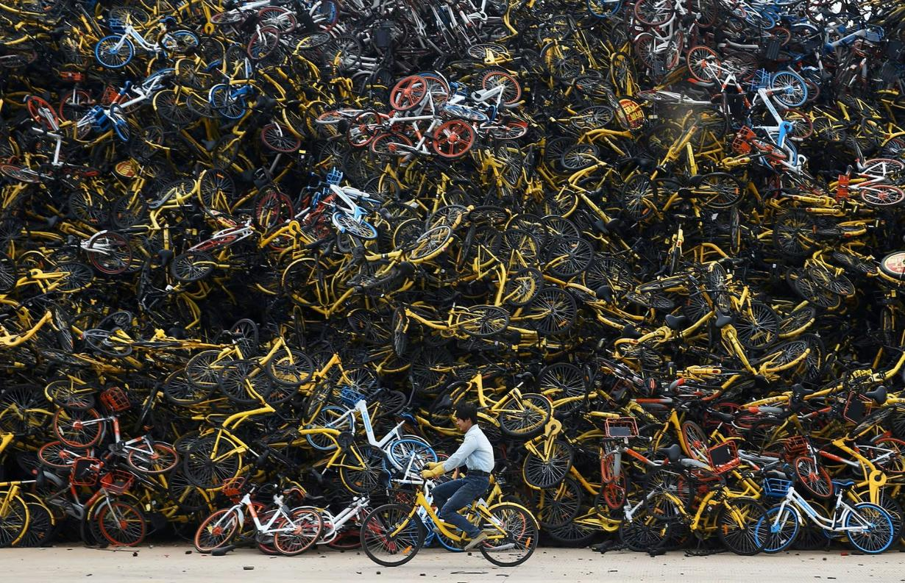
Some things I’m not going to talk about
Alan Taylor, The Atlantic, March 22, 2018
Bias in AI
Sustainability and AI
Economic/existential
impact of AI

Slide 6
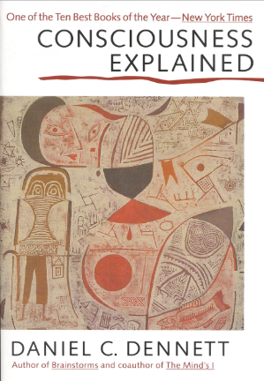
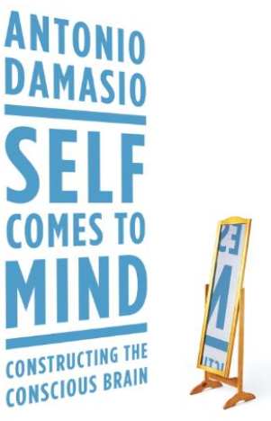
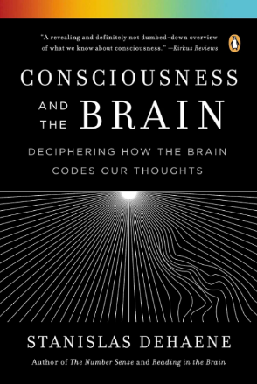
Some things I’m not going to talk about
Bias in AI
Sustainability and AI
Economic/existential impact
Consciousness and AI
consciousness
sentience
1991
2010
2014

Slide 7
what I am going to talk about
reinforcement learning
Part 1. Background: The revolution in artificial intelligence
  The two pillars of the AI revolution: RL and DL
Part 2: How a computer program’s operations can resemble human cognition
  One concrete example of a computer program “thinking”: object recognition
  The mechanism for artificial thinking to arise: emergence
  The final answer: Yes, some parts of some computer programs operate in a way that resembles certain cognitive processes in humans.
deep learning
(with deep neural networks)

Slide 8
The revolution in artificial intelligence: RL + DL
The two pillars of the modern AI revolution are
        Reinforcement learning
        Deep learning on deep neural networks
Turing award 2024: Sutton, Barto
Turing award 2018: Bengio, Hinton, LeCun
Nobel in Physics 2024: Hinton, Hopfield

Slide 9
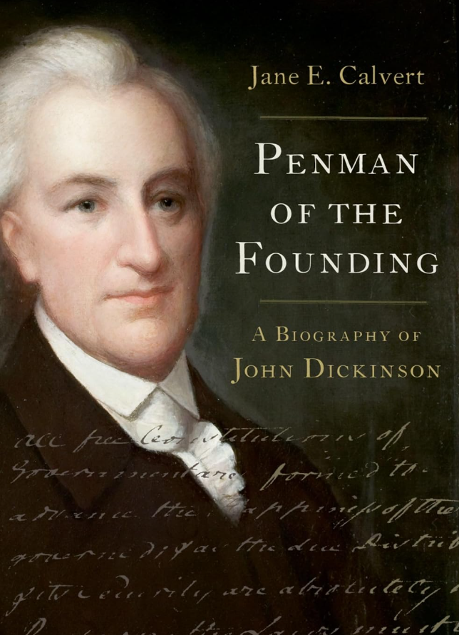


The revolution in artificial intelligence: RL + DL
  Stuart Russell, 2021 BBC Reith Lecture IV: “The Biggest Event in Human History”
  John Dickinson and Benjamin Rush: “Freedom is made safe through character and learning”
humans should aim to retain these in the face of AI

Slide 10
The revolution in artificial intelligence: RL + DL
The two pillars of the modern AI revolution are
        Reinforcement learning
        Deep learning on deep neural networks
Bilen & Azad, in progress
Kessler (2025)
Turing award 2024: Sutton, Barto
Forrester & Deitch, in progress
Huang & L. Wang (2026)
X. Wang (2025)
Turing award 2018: Bengio, Hinton, LeCun
Nobel in Physics 2024: Hinton, Hopfield

Slide 11
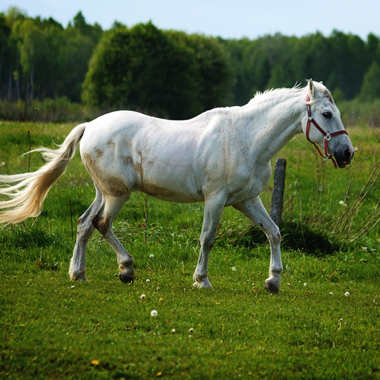






























A deep neural network
unit (or artificial neuron)
input layer
(numbers representing audio, video, text, etc.)
hidden layers
(numbers representing current “state of mind” / ”thinking”)
output layer
(numbers representing the answer)
0.01
0.85
cat
“horse”
0.13
0.03
dog
0.52
0.52
0.62
parameters
(or weights)
0.96
0.65
0.65
horse
computes values in next layer by multiplying and adding values in previous layer
e.g. = 0.71 + 0.38 = 0.62

Slide 12
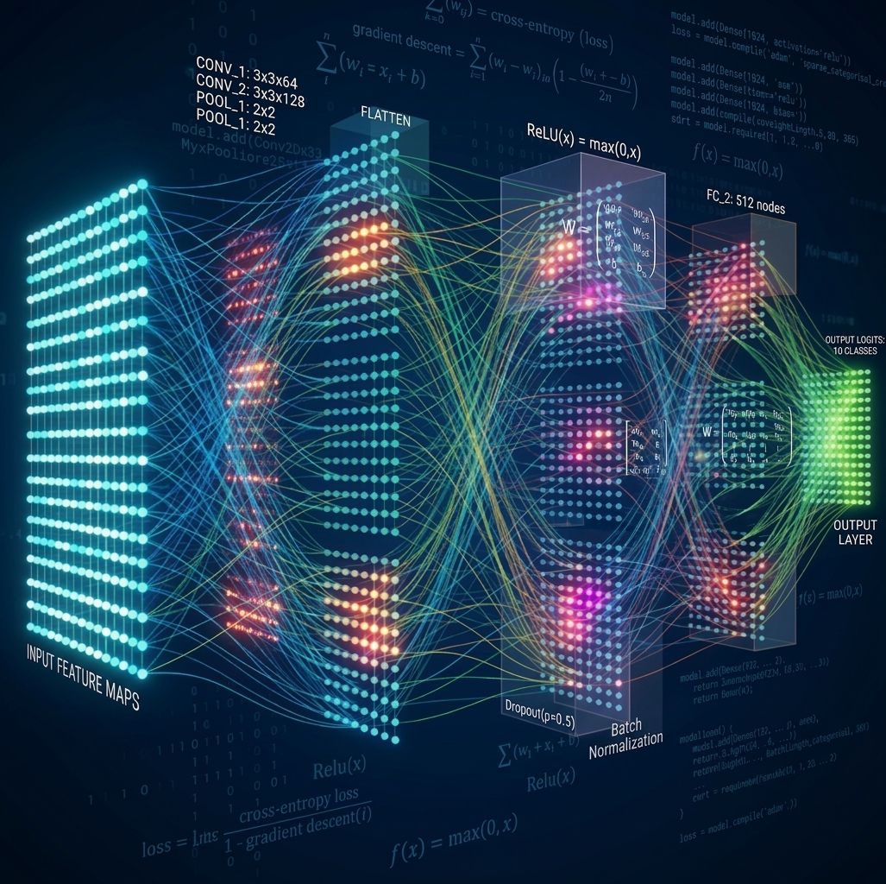
Less than 1% of a real-life deep neural network
Generated by gemini.google.com

Slide 13
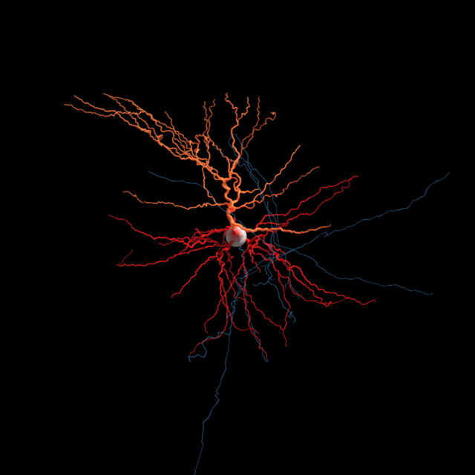
A biological neuron
Allen Institute for Brain Science

Slide 14
what I am going to talk about
reinforcement learning
Part 1. Background: The revolution in artificial intelligence
  The two pillars of the AI revolution: RL and DL
Part 2: How a computer program’s operations can resemble human cognition
  One concrete example of a computer program “thinking”: object recognition
  The mechanism for artificial thinking to arise: emergence
  The final answer: Yes, some parts of some computer programs operate in a way that resembles certain cognitive processes in humans.
deep learning
(with deep neural networks)

Slide 15
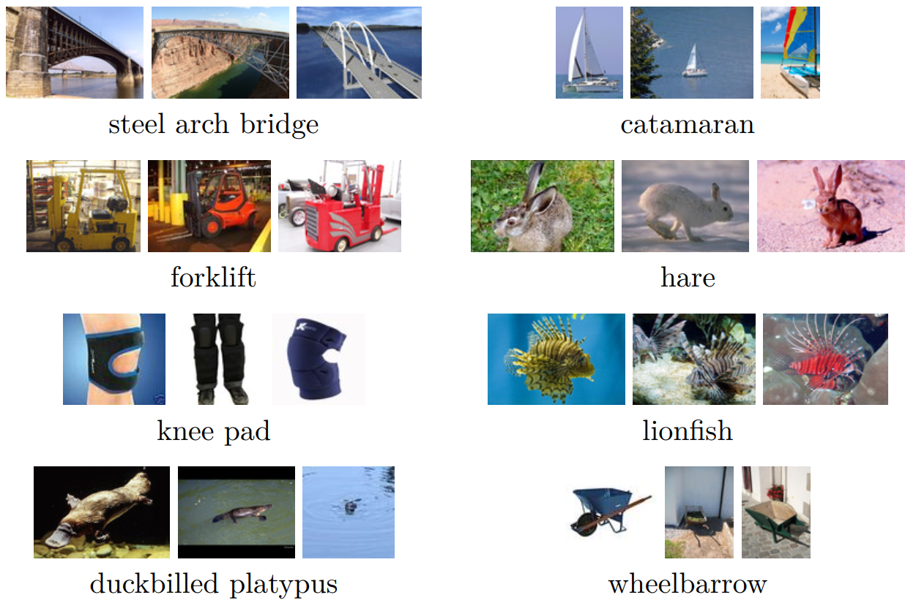
The ImageNet challenge
1000 object classes
1.3M training images
100K test images
Jia Deng, Fei-fei Li et al. (2009)
Russakovsky, Deng, Li et al. (2015)

Slide 16
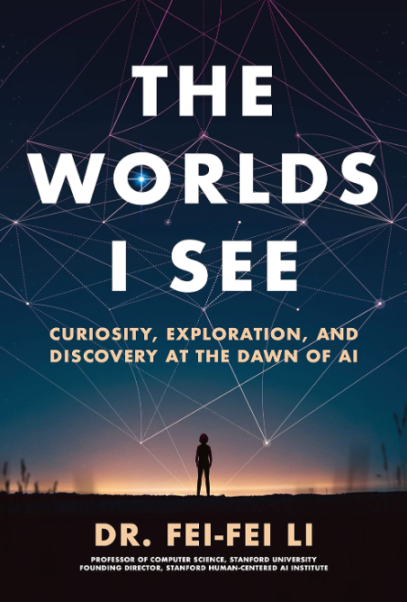


The ImageNet challenge
Fei-Fei Li: “Seriously? A neural network?”
Jia Deng: “Yeah. But there's more. Fei-Fei, you won't believe how well this thing is performing.”
AlexNet (2012)
Krizhevsky, Sutskever, Hinton

Slide 17


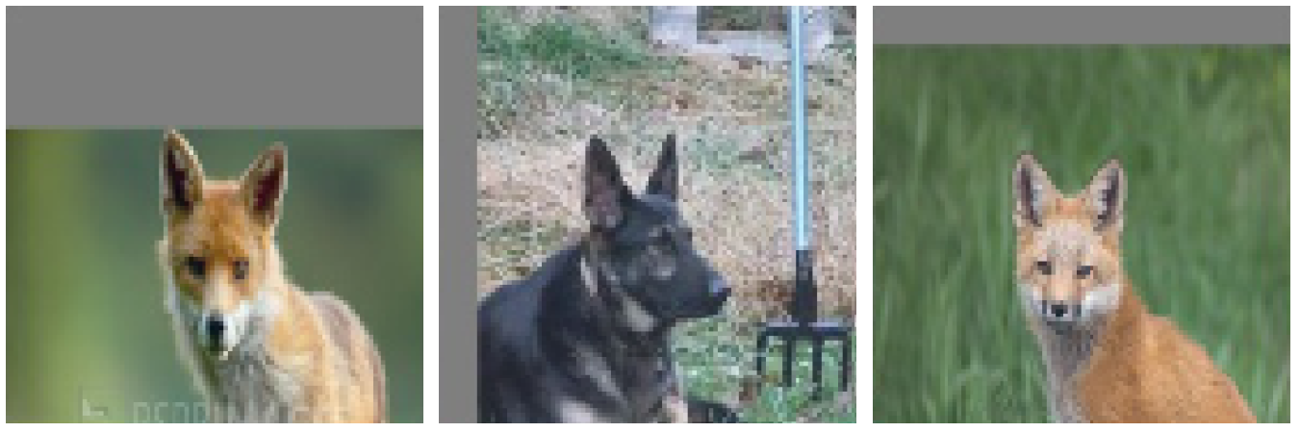

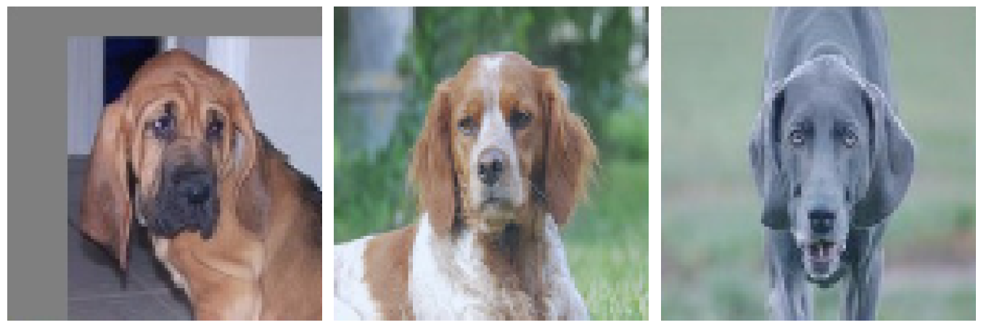
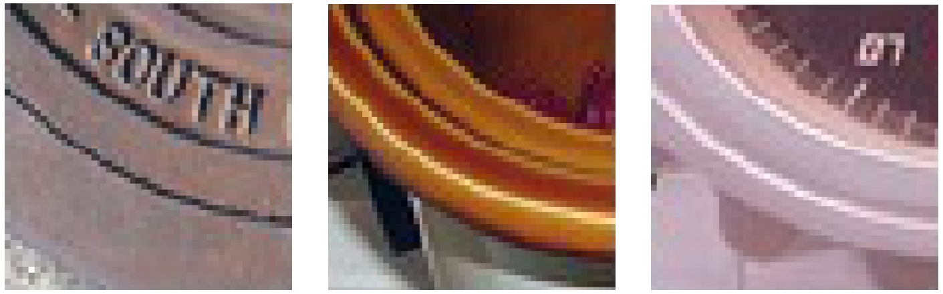
















Low-level, mid-level, and high-level neurons automatically acquire roles that mirror the human visual system
output
input
wheelbarrow 0.91
About 10 layers, 15 million neurons,
>100 million connections
hare 0.02
Hubel & Wiesel (1959)
1000 output
categories
Boosung Kim ’25

Slide 18
Apparent paradox: A single neuron merely adds and multiplies a few numbers, so how can it understand the concept of “pointy ears”?

Slide 19
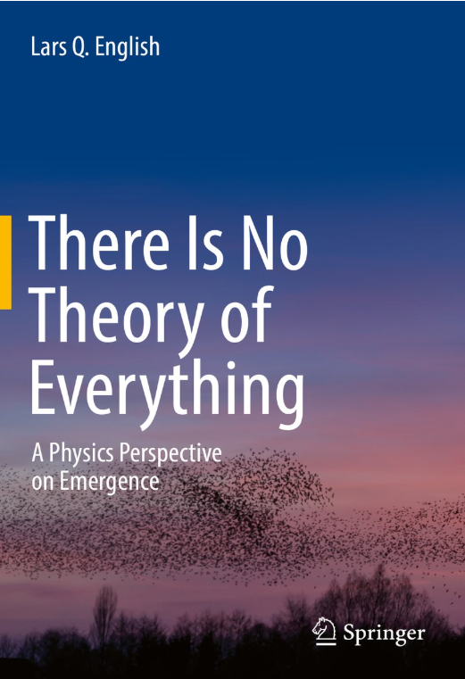
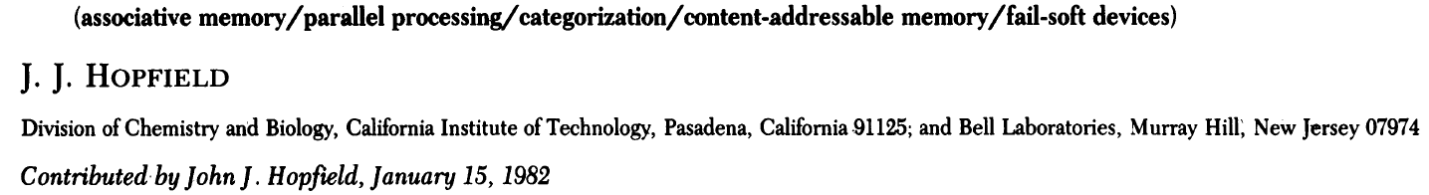

Emergent phenomena arise from the interactions of many simple components
one water molecule is not fluid
one gold atom is not metallic
one neuron is not conscious
one amino acid is not alive
– Jochen Fromm, The Emergence of Complexity (2004)

Slide 20
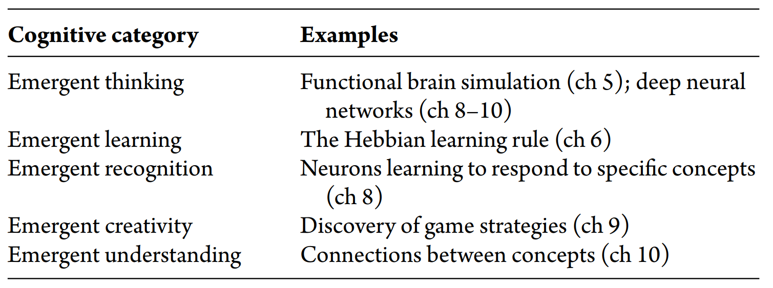
Apparent paradox: A single neuron merely adds and multiplies a few numbers, so how can it understand the concept of “pointy ears”?
Resolution of the paradox:
The understanding is an emergent phenomenon, arising from the complex interactions of many simple artificial neurons.
We could call this
  emergent understanding, or
  artificial understanding, or
  just “understanding”
I use “emergent”, as in
  emergent AI
jm, Thinking AI (2026)
Lucretius: “I will go on to tell of what components this same mind is formed ... it is superfine, composed of tiniest particles”
(~50 BCE)

Slide 21
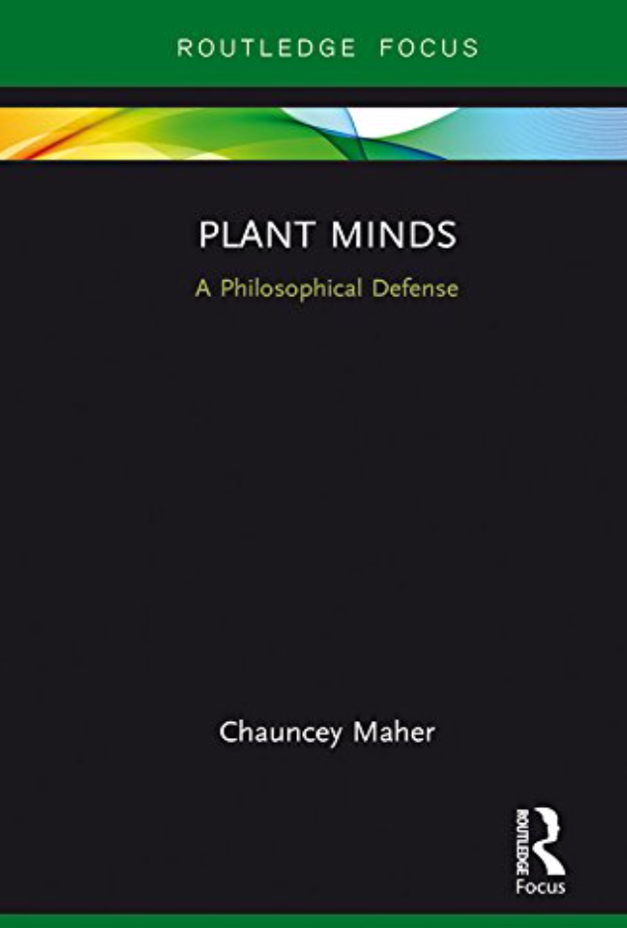
Can a computer program think like a human?
Yes, some parts of some computer programs operate in a way that resembles certain cognitive processes.
How about we call this “emergent thinking”?

Slide 22
THANK YOU to many people 🙏🙏🙏
Dickinson folks:
Eren Bilen
Lars English
Tiffany Frey
Boosung Kim ’25
Chauncey Maher
Kristine Mitchell
Missy Niblock
David Richeson

Slide 23
Kwame Anthony Appiah: “...not just what it enables us to do but also what manner of people we become in doing it.” (2026)
via Melinda Schlitt
D Graham Burnett: “The work of being here—of living, sensing, choosing—still awaits us.” (2025)

Slide 24




Things fall apart; the centre cannot hold;
Mere anarchy is loosed upon the world,
The blood-dimmed tide is loosed, and everywhere
The ceremony of innocence is drowned;
The Second Coming
W B Yeats, 1919
Upon the upland road
Ride easy, stranger:
Surrender to the sky
Your heart of anger.
High Country Weather
James K Baxter, 1948
apocalypse? … or … serenity?
Iris Murdoch (echoing Plato): “seeing the
order of the world in the light of the Good.”
(1967)

Slide 25
Can a computer program think like a human?
Yes, some parts of some computer programs operate in a way that resembles certain cognitive processes.
How about we call this “emergent thinking”?

Slide 26
[end of main presentation]

Slide 27
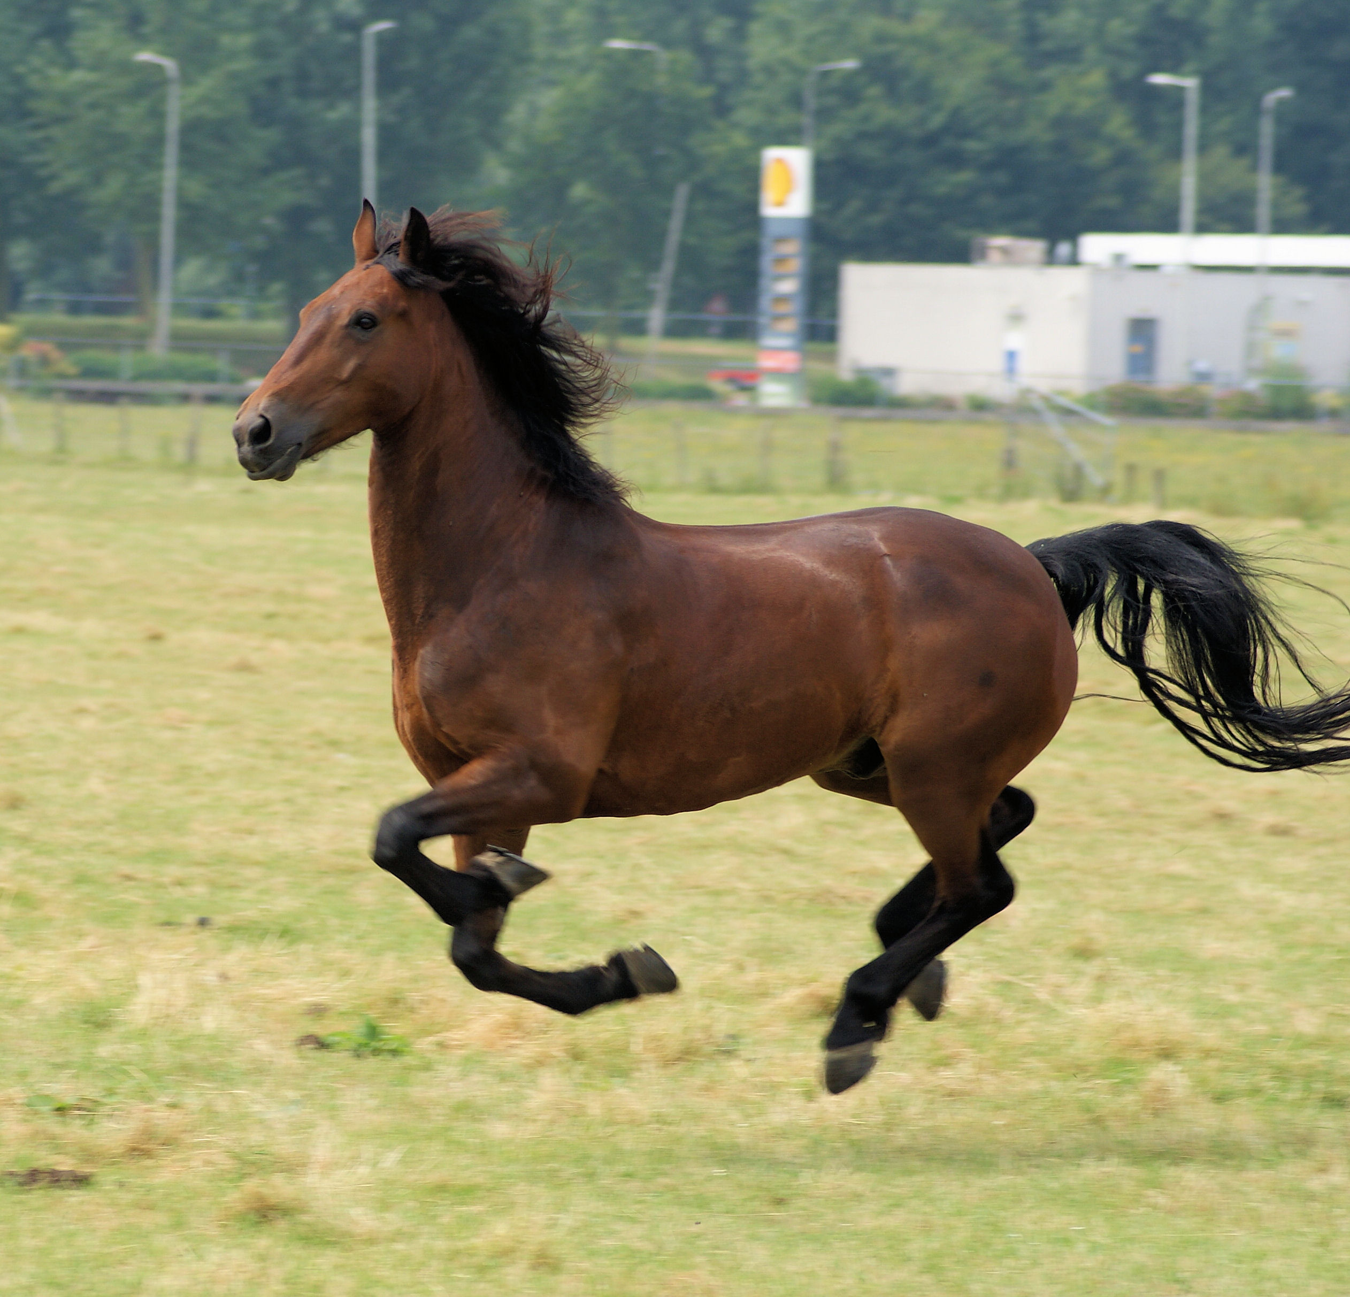






















Deep learning
learning uses labeled data
“horse”
input layer
(numbers representing audio, video, text, etc.)
hidden layers
(numbers representing current “state of mind” / ”thinking”)
output layer
(numbers representing the answer)
0.60
0.44
cat
0.91
0.30
dog
0.52
0.62
0.10
0.65
horse
e.g. = 0.71 + 0.38 = 0.62

Slide 28
References (slide 1 of 5)
Allen Institute (Mar. 2019). 5 Unsolved Mysteries About the Brain. Online article authored by Rachel Tompa. Allen Institute for Brain Science. https://alleninstitute.org/news/5-unsolved-mysteries-about-the-brain
Appiah, Kwame Anthony (July 2026). “AI is changing what we can do. Who we become is still our choice.” The Humanist Review of AI, 01.
Baxter, James K. (1948). “High Country Weather.” In Blow, Wind of Fruitfulness. Christchurch, New Zealand: Caxton Press.
Bengio, Yoshua, et al. (2003). “A Neural Probabilistic Language Model.” Journal of Machine Learning Research, 3, 1137–1155.
Bilen, Eren, and Pranav Azad (2026). “AI for Rubik’s Cube: Mimicking Human Solve.” Work in progress. https://ernbilen.github.io/WPs.html
Burnett, D. Graham (Apr. 2025). “Will the Humanities Survive Artificial Intelligence?” The New Yorker. https://www.newyorker.com/culture/the-weekend-essay/will-the-humanities-survive-artificial-intelligence
Calvert, Jane E. (2024). Penman of the Founding: A Biography of John Dickinson. New York: Oxford University Press. ISBN 9780197541692.
Damasio, A. (2010). Self Comes to Mind: Constructing the Conscious Brain. Pantheon.
Dehaene, Stanislas (2014). Consciousness and the Brain: Deciphering How the Brain Codes Our Thoughts. Viking.
Deng, Jia, et al. (2009). “ImageNet: A Large-Scale Hierarchical Image Database.” In Proceedings of the IEEE Conference on Computer Vision and Pattern Recognition, 248–255. https://doi.org/10.1109/CVPR.2009.5206848
Dennett, Daniel C. (1991). Consciousness Explained. Little, Brown and Co.

Slide 29
References (slide 2 of 5)
English, L. Q. (2017). There Is No Theory of Everything: A Physics Perspective on Emergence. Springer. ISBN 9783319591506. https://books.google.com/books?id=1fwwDwAAQBAJ
Forrester, R., and Z. Deitch (n.d.). “Predicting Effective Linearizations for 0-1 Quadratic Programs via Multi-Class Classification.” Work in progress.
Fromm, J. (2004). The Emergence of Complexity. Kassel University Press. ISBN 9783899580693. https://books.google.com/books?id=lzRVAAAACAAJ
Hinton, Geoffrey E., Simon Osindero, and Yee-Whye Teh (2006). “A Fast Learning Algorithm for Deep Belief Nets.” Neural Computation, 18(7), 1527–1554.
Hopfield, John J. (1982). “Neural Networks and Physical Systems with Emergent Collective Computational Abilities.” Proceedings of the National Academy of Sciences, 79(8), 2554–2558.
Huang, Xiaoyu, and Lulu Wang (2026). “Emergent Latent-State Computation under Stochastic Volatility.” arXiv preprint arXiv:2607.25459. Also presented at ICML 2026 Mechanistic Interpretability Workshop.
Hubel, David H., and Torsten N. Wiesel (1959). “Receptive Fields of Single Neurones in the Cat’s Striate Cortex.” The Journal of Physiology, 148(3), 574–591.
Kessler, Zachary (2025). “Monetary Policy Quality and Institutional Central Bank Structure: A Reinforcement Learning Approach.” Available at SSRN. https://doi.org/10.2139/ssrn.4596355; https://ssrn.com/abstract=4596355
Kim, Boo Sung (July 2021). “Visualization of Deep Convolutional Neural Networks.” Unpublished research project.

Slide 30
References (slide 3 of 5)
Krizhevsky, Alex, Ilya Sutskever, and Geoffrey E. Hinton (2012). “ImageNet Classification with Deep Convolutional Neural Networks.” In Advances in Neural Information Processing Systems, edited by F. Pereira et al., vol. 25, 1097–1105. https://proceedings.neurips.cc/paper_files/paper/2012/file/c399862d3b9d6b76c8436e924a68c45b-Paper.pdf
LeCun, Yann, et al. (1998). “Gradient-Based Learning Applied to Document Recognition.” Proceedings of the IEEE, 86(11), 2278–2324. https://doi.org/10.1109/5.726791
Li, Fei-Fei (2023). The Worlds I See: Curiosity, Exploration, and Discovery at the Dawn of AI. Flatiron Books.
Lucretius (n.d.). De Rerum Natura. Written c. 55 BCE; quotation is author’s paraphrase of the 1916 Leonard translation; from Book 3, “Nature and Composition of the Mind.”
MacCormick, John (2023). “I Unintentionally Created a Biased AI Algorithm 25 Years Ago – Tech Companies Are Still Making the Same Mistake.” The Conversation, May 9, 2023. https://bit.ly/biasedAlg5-9-2023
MacCormick, John (2026). Thinking AI: How Artificial Intelligence Emulates Human Understanding. 282 pp. Princeton University Press.
Maher, Chauncey (2017). Plant Minds: A Philosophical Defense. Routledge.
Murdoch, Iris (1967). The Sovereignty of Good Over Other Concepts. 1967 Leslie Stephen lecture. Reprinted in The Sovereignty of Good, 1970. Cambridge University Press.
Russakovsky, Olga, et al. (2015). “ImageNet Large Scale Visual Recognition Challenge.” International Journal of Computer Vision, 115(3), 211–252. https://doi.org/10.1007/s11263-015-0816-y
Sutton, Richard S., and Andrew G. Barto (2018). Reinforcement Learning: An Introduction. 2nd ed. MIT Press.
Wang, Xiaolu (Oct. 2025). “Tug-of-War of Emotion: Measuring and Modeling Sentiment Cycles in Chinese-Language Pop Song Lyrics, 1967–2023.” Journal of Cultural Analytics, 10(2). https://doi.org/10.22148/001c.144809; https://culturalanalytics.org/article/id/1052/
Yeats, William Butler (1920). “The Second Coming.” In Michael Robartes and the Dancer. Poem originally published 1919. Dundrum, Ireland: Cuala Press.

Slide 31
References (slide 4 of 5)
Krizhevsky, Alex, Ilya Sutskever, and Geoffrey E. Hinton (2012). “ImageNet Classification with Deep Convolutional Neural Networks.” In Advances in Neural Information Processing Systems, edited by F. Pereira et al., vol. 25, 1097–1105. https://proceedings.neurips.cc/paper_files/paper/2012/file/c399862d3b9d6b76c8436e924a68c45b-Paper.pdf
LeCun, Yann, et al. (1998). “Gradient-Based Learning Applied to Document Recognition.” Proceedings of the IEEE, 86(11), 2278–2324. https://doi.org/10.1109/5.726791
Li, Fei-Fei (2023). The Worlds I See: Curiosity, Exploration, and Discovery at the Dawn of AI. Flatiron Books.
Lucretius (n.d.). De Rerum Natura. Written c. 55 BCE; quotation is author’s paraphrase of the 1916 Leonard translation; from Book 3, “Nature and Composition of the Mind.”
MacCormick, John (2023). “I Unintentionally Created a Biased AI Algorithm 25 Years Ago – Tech Companies Are Still Making the Same Mistake.” The Conversation, May 9, 2023. https://bit.ly/biasedAlg5-9-2023
MacCormick, John (2026). Thinking AI: How Artificial Intelligence Emulates Human Understanding. 282 pp. Princeton University Press.
Maher, Chauncey (2017). Plant Minds: A Philosophical Defense. Routledge.
Murdoch, Iris (1967). The Sovereignty of Good Over Other Concepts. 1967 Leslie Stephen lecture. Reprinted in The Sovereignty of Good, 1970. Cambridge University Press.

Slide 32
References (slide 5 of 5)
Russakovsky, Olga, et al. (2015). “ImageNet Large Scale Visual Recognition Challenge.” International Journal of Computer Vision, 115(3), 211–252. https://doi.org/10.1007/s11263-015-0816-y
Sutton, Richard S., and Andrew G. Barto (2018). Reinforcement Learning: An Introduction. 2nd ed. MIT Press.
Wang, Xiaolu (Oct. 2025). “Tug-of-War of Emotion: Measuring and Modeling Sentiment Cycles in Chinese-Language Pop Song Lyrics, 1967–2023.” Journal of Cultural Analytics, 10(2). https://doi.org/10.22148/001c.144809; https://culturalanalytics.org/article/id/1052/
Yeats, William Butler (1920). “The Second Coming.” In Michael Robartes and the Dancer. Poem originally published 1919. Dundrum, Ireland: Cuala Press.

