Slide 1
July 1, 2026 Open Enrollment
Alera Group – Relph Benefit Advisors

Slide 2
Agenda
Open Enrollment Overview
Health Plan: Medical & Prescription Drug Coverage
Dental & Vision Plans
Flexible Spending
Life Insurance, Accidental Death & Dismemberment, & Long-Term Disability
Additional Voluntary Benefits
Health Advocate

Slide 3

Open Enrollment
Enroll in your benefits Monday, May 11 through Monday, May 25
Enrollments effective July 1, 2026
Only time of the year to:
Enroll in or Change Plans
(Re) Enroll in the FSA Plan
Add or Remove Dependents
Changes during the year are limited to qualifying events
& a 31-day window.

Slide 4
Health Plan Coverage

Slide 5

Medical Plan Overview
Meritain will continue for July 1, 2026
  Independent company of Aetna
  Members will continue to use the Aetna Choice POS II (Open Access) Network
Visit providers without referral & PCPs are not required (but recommended)
Preventative Services Covered by the Plan
  Well-Child Visits, Adult Physical (One/Contract Year)
  Screening Mammography, Pap Tests,
  Immunizations
Teledoc telemedicine program - $25 Copay for Acute Illnesses & Mental Health
Dependents Covered to Age 26

Slide 6
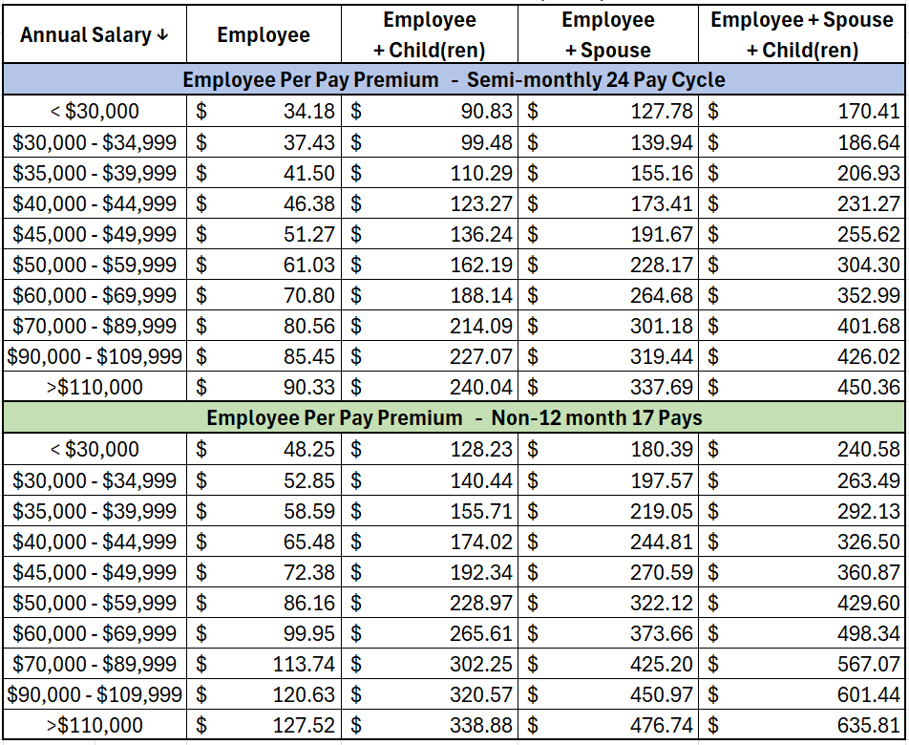
Health Plan Per Pay Costs
Medical Plan deductions effective
July 1, 2026
* Premiums will be deducted from the first two pay dates each month for bi-weekly paid employees.

Slide 7
Aetna Choice POS II
Plan Changes for July 1, 2026
Service | In-Network | Out-of-Network
Deductible | $500 $625 Person $1,500 $1,875 Family | $800 $1,000 Person $2,400 $3,000 Family
Coinsurance | Member pays 10%, after deductible | Member pays 30%, after deductible
Medical Out-of-Pocket Max* | $1,500 Person / $4,500 Family $1,875 Person / $5,625 Family | $1,950 Person / $5,850 Family $2,000 Person / $6,000 Family
Primary Care | $20 $25 copay | Deductible & Coinsurance
Specialist | $25 copay | Deductible & Coinsurance
Mental Health Office Visit | $25 copay | Deductible & Coinsurance
Diagnostic Labs | Deductible & 10% Coinsurance | Deductible & Coinsurance
Inpatient Hospital | $200 copay, then 10% coinsurance after deductible | Deductible & Coinsurance
Urgent Care | $40 $50 copay | Deductible & Coinsurance
Emergency Room | $125 $150 copay (waived if admitted) | $125 $150 copay (waived if admitted)
*Deductibles, coinsurance, and co-pays contribute toward the Out-of-Pocket Max.

Slide 8


Meritain Member Portal
Website available to all enrolled members – Register now!
  Review benefits and coverage
  View and download claims
  View Explanation of Benefits (EOBs)
  Access benefit plan documents
  Find a doctor
  Access member ID cards
Register or log in at
www.meritain.com

Slide 9
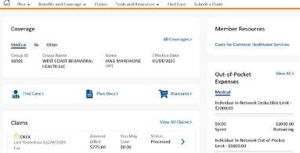
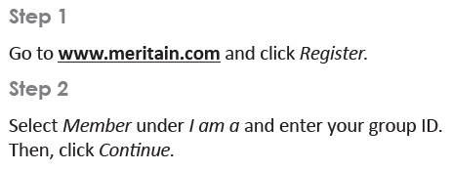


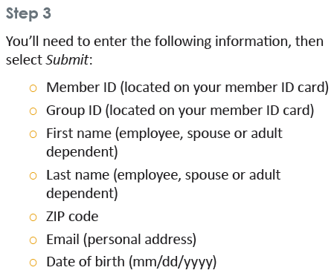
How to Register
You can access the portal by computer, tablet or via the Meritain Health mobile app on your iPhone® or Android™.

Slide 10
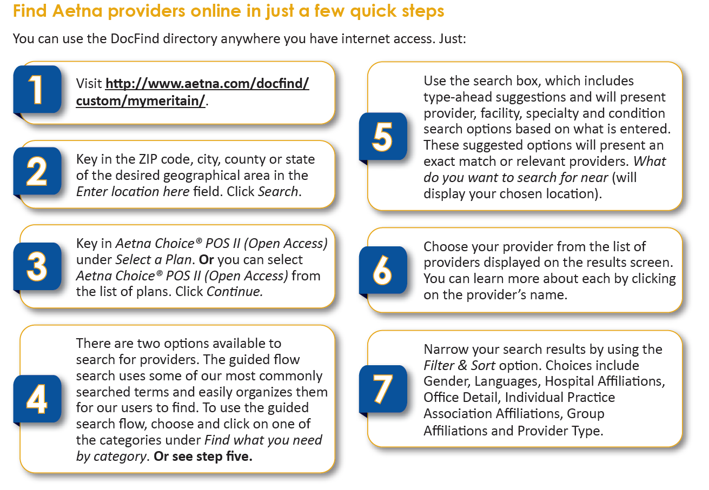
DocFind Provider Directory
*No Change to current provider network

Slide 11

Teledoc Telemedicine Program
Alternative to receive care by visiting a certified medical doctor right from your home, office or on the go for non-emergency medical conditions. Available 24/7/365
Physicians will diagnose your symptoms, prescribe medications (when appropriate) and send the prescription to your nearest pharmacy.
When to Use:
  Primary care doctor is not available
  Instead of going to the ER or Urgent Care (for a non-emergency)
  Traveling and in need of medical care
Treatable Common Conditions:
Allergies, Asthma, Bronchitis, Cold/Flu, Diarrhea, Ear Infections, Fever, Headache, Infections, Insect Bites, Joint Aches, Rashes, Sinus Infections, Skin Infections, Sore Throat

Slide 12
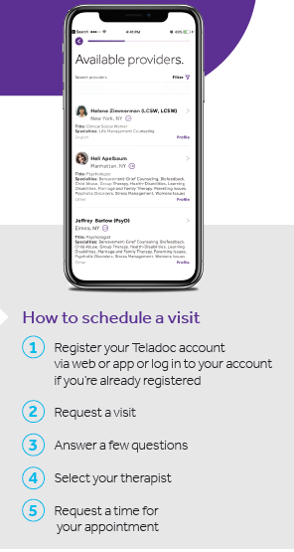
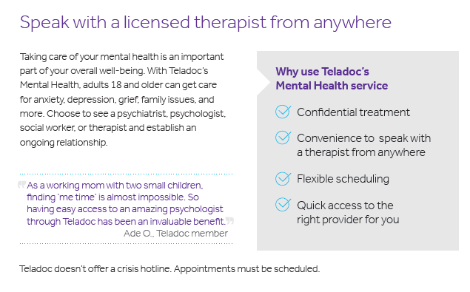
Behavioral Health on Teledoc
“Confidential therapy on your terms”

Slide 13

Meritain Precertification
Meritain medical management team will help
you get the most appropriate care, when
and where you need it.
Precertify before the following:
Hospital admissions
Inpatient or outpatient surgery
IV home infusion therapy or chemotherapy
Inpatient substance abuse treatment
Home health care
Admission to an extended care or rehab care facility
Call before you get care
You or your doctor can call Meritain Health Medical Management to verify which procedures need to be precertified.

Slide 14
Additional Meritain Member Resources
Pre-Admission and Post-Discharge Counseling
  Provides educations to members receiving inpatient procedures
Maternity Management
  Connecting members with maternity nurse specialist (RN’s) for the duration of pregnancy
Institutes of Quality
  Aetna network includes special network of hospitals and facilities known for providing quality care
Product Discounts
  Meritain provides health discounts for healthcare products including blood pressure monitor, electrotherapy,

Slide 15
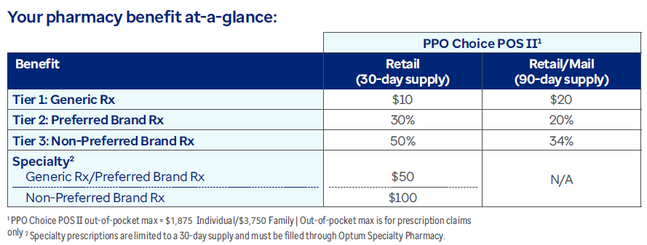

OptumRx Prescription Drug Plan
Formulary is the list of medications covered by the plan. Updated twice per year based on latest research & clinical evidence. Deductibles / Copays are determined by the Tier;
Generics – safe, effective & have the same active ingredients as a brand name medication, but cost an average of 85% less (brands with expired patents)
Preferred – Lower cost or more clinically effective than non-preferred or excluded
Non-Preferred – Highest cost or medications with clinical alternatives
Specialty – Complex medications purchased through a specialty pharmacy
Excluded –Medications with clinical alternatives or generics that are not covered by the plan. Members must choose an alternative therapy.

Slide 16
Pharmacy Plan Details
Per the Formulary, medications may require treatment protocols including;
Quantity Limits – for safety & cost reasons, the plan limits the amount of drugs they cover over a certain period of time
Prior Authorization – to be sure that medications are prescribed and used correctly, before the plan will cover a particular drug, your doctor or your prescriber must first show that you have a medically necessary need for that particular drug and/or have met the requirements for the drug.
Step Therapy – you must first try a less expensive drug on the formulary that has been proven effective for most people with your condition before you can move up a “step” to a more expensive drug. However, if you have already tried the more affordable drug and it didn’t work or if your prescriber believes that it is medically necessary for you to be on a more expensive drug, they can contact the plan to request an exception.
Specialty Prescriptions
Fill through Optum Specialty Pharmacy only, start the process prior to July 1 with your doctor to avoid any delays!
Ask about coupon programs to help cover your copays
Members impacted by formulary changes & exclusions will receive letters directly from OptumRx. Speak with your physician to avoid any interruptions in treatment.

Slide 17
Pharmacy Plan Details – Mail Order
Purchase a 90-Day Supply – deductible or 2.5 copays, convenience of Auto Refill, the medication is sent automatically & Auto Renewal, OptumRx renews your prescription with your doctor.
New service requires a minimum 90-day or annual script from your doctor
Provide home delivery pharmacy with…
Scripts (have your doctor e-scribe them directly)
Payment Method
Mailing Address

Slide 18
Pharmacy Plan Details
Helpful Hints
Flu &/or Covid Vaccines in the Pharmacy – No Member Copay via OptumRx coverage
Traveling Overseas – Plan ahead with scripts & a prior authorization for the length of travel plus return time
Diabetics – free meters available through OptumRx program
If you are having any issues purchasing your medications, please contact HR or Alera Group. We will need the patient, medication, dosage & the pharmacy details.
  Need a refill as the patient & provider work through prior authorization
  Need a refill of your existing script if step therapy is required
  Need a refill as you transition to a new specialty pharmacy
  Need a refill of an excluded medication as you speak with your doctor to transition to a new medication…and any other issues.

Slide 19

DickinsonCRX Program
International mail order drug program
  $0 copay for 90 day supply on certain brand name drugs
  Visit http://www.dickinsoncrx.com/ for the full list of eligible medications and more information on the program
  Access information for CRX International by visiting www.crxintl.com
    LOG-IN by entering the Web ID: DICKINSON
What is needed to enroll in the program:
Completed enrollment form
New prescription for each medication
Copy of photo ID

Slide 20
Dental Coverage

Slide 21

Dental Plan Overview
No Change in Plan Design or Employee Premiums for July 1, 2026
Dickinson College continues to offer two dental plans to benefit eligible employees and dependents
Dependent children covered to age 26
Find a provider at www.unitedconcordia.com
  Dental network: Elite Plus
Create an account at www.unitedconcordia.com
  Review coverage information
  Check claim status
  Print ID cards

Slide 22
Dental Per Pay Deductions
Concordia Choice – High Option
Premium Deduction Frequency | Employee (EE) | EE + Spouse or EE + Child | EE + Spouse + Child(ren) or EE + Children
Semi-monthly 24 Pays* | $11.36 | $23.86 | $44.45
Non-12 month 17 Pays | $16.04 | $33.68 | $62.75
Concordia Select – Low Option
Premium Deduction Frequency | Employee (EE) | EE + Spouse or EE + Child | EE + Spouse + Child(ren) or EE + Children
Semi-monthly 24 Pays* | $10.33 | $20.95 | $34.61
Non-12 month 17 Pays | $14.59 | $29.57 | $48.87
* Premiums will be deducted from the first two pay dates each month for bi-weekly paid employees.

Slide 23
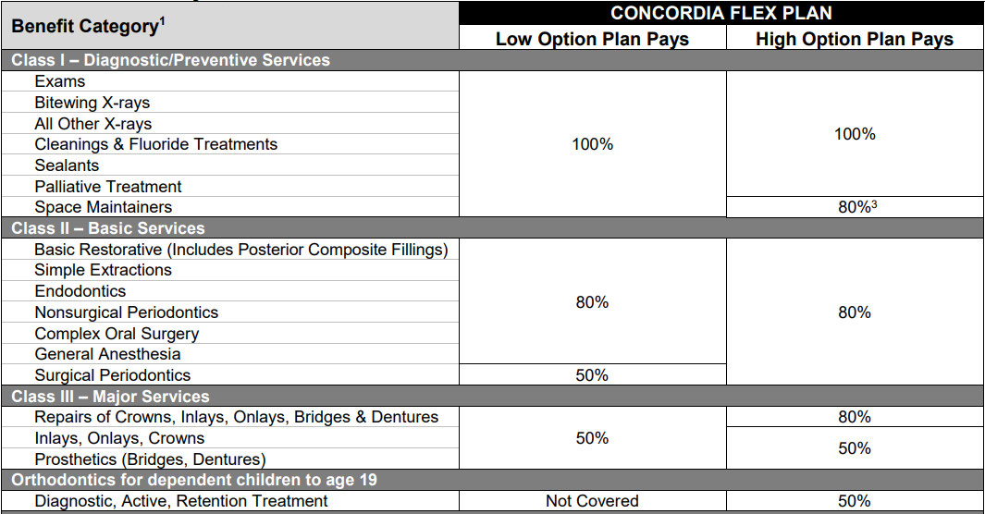
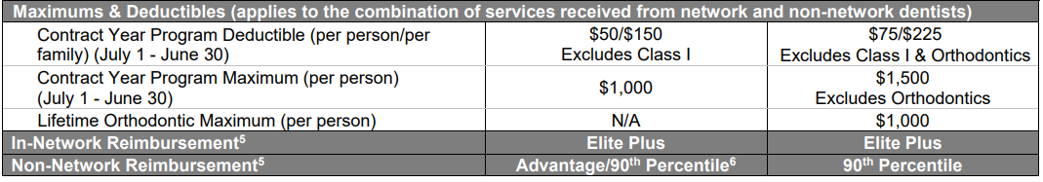

Slide 24

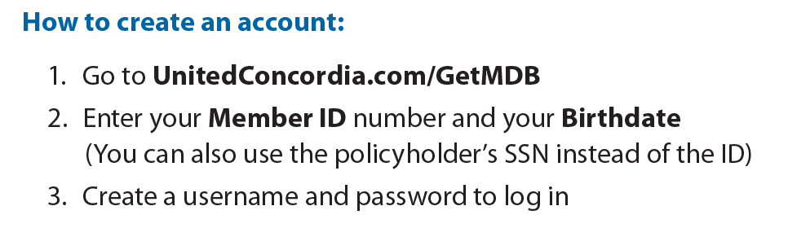
MyDentalBenefits Account
Creating an online account with United Concordia’s MyDentalBenefits gives you 24/7 access to information on your dental plan:
See your plan benefits
Check the status of claims and access EOB’s
Find a dentist near you
Chat live with customer service
Print ID cards

Slide 25
Vision Coverage

Slide 26

Vision Plan Overview
No Change in Plan Design or Employee Premiums for July 1, 2026
Dickinson College continues to offer vision coverage through Vision Benefits of America (VBA)
Dependent children covered to age 26
Log in to your vision member account at www.vbaplans.com
  Find a participating provider to maximize your benefits
  Access your eligibility for services
  View your claim history and plan coverage
  View/Print ID card, (card not necessary to access benefits)
  Access out-of-network claim instructions
Vision services frequency
  Routine exam – once every 12 months
  Lenses – once every 12 months
  Frames – once every 24 months

Slide 27
Vision Per Pay Deductions
Premium Deduction Frequency | Employee (EE) | EE + Spouse or EE + Child | EE + Spouse + Child(ren) or EE + Children
Semi-monthly 24 Pays* | $1.53 | $3.56 | $5.18
Non-12 month 17 Pays | $2.16 | $5.03 | $7.31
* Premiums will be deducted from the first two pay dates each month for bi-weekly paid employees.

Slide 28
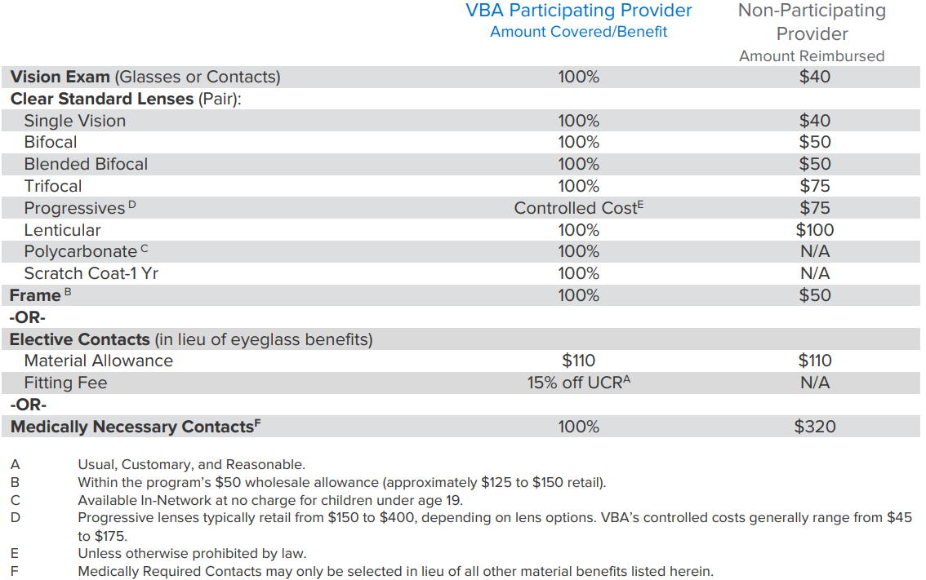
Vision Benefits

Slide 29
Flexible Spending

Slide 30

Flexible Spending Accounts (FSA)
Benefit MUST BE (re)elected every year!
Administered by Ameriflex
Pre-tax dollars set aside to pay for health or dependent care expenses.
Accounts are “Use It or Lose It“ rule!
Healthcare Spending Account (HCFSA)
  $3,400 Annual Maximum
  Benefit is fully funded July 1 if your expenses occur early in the year
  Covers medical, RX, dental & vision expenses for employee, spouse & children
  Covers OTC and feminine hygiene products
Dependent Care Reimbursement Account (DCFSA)
  Up to $7,500 “family” Annual Maximum (requires Tax ID# of provider)
*Grace Period to incur claims & use 2025-2026 flex money ends September 15, 2026. All claims MUST be submitted by October 31, 2026. Submissions MUST be dated prior to 9/16/2026.

Slide 31
Ameriflex Debit Card
Once enrolled in a Flexible Spending Account, members will receive a Benefits Mastercard from Ameriflex:
  The card may be used to pay for eligible expenses under IRS guidelines, including:
    doctor's visit and prescription drug co-pays
    medical plan deductibles
    eligible medical, dental or vision expenses that are not covered by any other plan.
  The card may be used to pay for eligible expenses at approved merchants that accept MasterCard
  Expenses are limited to your elected annual maximum.
  You must keep copies of all receipts for which you use your card. Ameriflex might request those receipts. If they are requested, and you fail to provide them, your card may be temporarily inactivated.

Slide 32
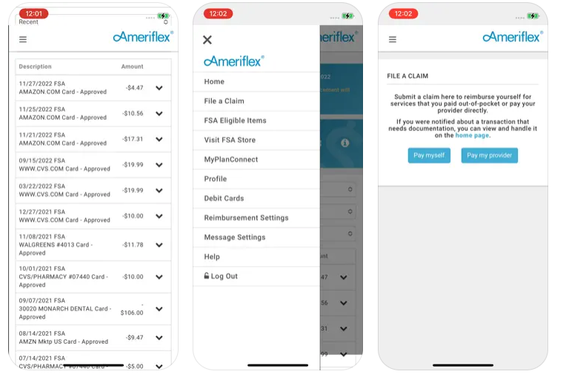
Ameriflex Member Portal and Mobile App
Create a Ameriflex online account at:
www.myameriflex.com/login
  Track balances
  Submit claims
  Access account history
  Order replacement debit cards
  Download forms
Mobile App
Search “Ameriflex” in app store
  File claims with camera-based receipt imaging
  Get text alerts for balance and transaction inquiries

Slide 33
Ameriflex ID Theft Protection
All Ameriflex cardholders will receive complimentary access to Mastercard’s leading Identity Theft Protection service.
Benefits Include:
24/7 ID theft resolution service
Online identity monitoring dashboard
Credit monitoring, report and score
Suspicious activity alerts
Learn more and register at:
www.myameriflex.com/idtheftprotection

Slide 34

Support
Download the Mobile App
Call us at: 888.868.3539
Visit us at: www.myameriflex.com

Slide 35
Life Insurance, Accidental Death & Dismemberment and Long Term Disability

Slide 36

Life Insurance and Accidental Death & Dismemberment (AD&D)
Core Benefit – Paid for by Dickinson College
Benefit eligible employees covered by Term Life and AD&D Insurance
  Benefit amount of 3x salary to a maximum of $650,000 for FT Employees Hired Before January 1, 2008
  Benefit amount of 2x salary to a maximum of $650,000 for FT Employees Hired On or After January 1, 2008
Age reduction applies at ages 65, 70, and 75
Voluntary Benefit – Term Life and AD&D Insurance
  Evidence of Good Health required if enrolling after initial eligibility or for amounts greater than guaranteed issue coverage.
  Employees may elect increments of $10,000 to a maximum of $300,000. Age reduction applies at ages 65, 70, and 75.
  Spouse may elect $10k to lesser of $150k or 50% of employee amount
  Children to age 26, may elect increments of $2,500 to a maximum of $10,000

Slide 37
Long-Term Disability
Paid for by Dickinson College
Provided to benefit eligible employees
    Benefits begin after 180 days of disability.
    60% of base monthly earnings to a max of $10,000 per month.
    Payable to normal social security retirement age.

Slide 38

Voluntary Benefit – Accidental Death & Dismemberment (AD&D)
Additional accidental death and dismemberment coverage available to benefit eligible employees through The Hartford
  Elect $10,000 to $300,000 in coverage
  Any amount over $150,000 cannot exceed 10x salary
  Age reduction applies at ages 65 and 70

Slide 39
Additional Voluntary Benefits

Slide 40

Accident and Critical Illness
Personal Accident Indemnity Plan
  Accident Emergency Treatment
  Accident Follow-up Treatment
  Hospitalization Benefit; Initial, Confinement, ICU
  Major Diagnostic Exams
  Physical Therapy
  Accidental Death & Dismemberment
  Wellness Benefit, $60/year per participants (after 12 months of coverage)
Critical Illness Coverage
  Covered Illnesses include: cancer, heart attack, stroke, major organ transplant, renal failure, coronary bypass
  Wellness Benefit, $50/year per participant
Please visit https://www.aflacenrollment.com/DickinsonCollege/177915123144
for more information and to enroll in coverage

Slide 41

Home and Auto Insurance
Voluntary benefit offered to full-time employees at group-discounted rates
Coverage premiums paid through payroll deductions
100% portable - you take the coverage with you!
Options available:
  Home Boat Motor Home
  Auto Condo Motorcycle
  Personal Excess Liability Renter’s Recreational Vehicle
Call 1-800-438-6381 for more information or a free quote.

Slide 42


Pet Insurance
MetLife Pet Insurance provides for essential needs, such as accidents, illnesses, cancer, ear infections, and more. Optional protection is available for preventive care including flea & tick, spay/neuter, heartworm, behavioral training, etc.
Features:
Covers all breeds & ages
Optional wellness coverage
No waiting period for accidents, 14 days for illness
Hereditary, congenital and chronic conditions covered
Telehealth concierge service
Loss or theft coverage
Cremation & burial benefits, grief counseling
MetLife Pet mobile app
  Manage your pet’s health records online
  View policy, submit/track claims
  Live 24/7 vet chat
  Find nearby pet services
Policy premium paid monthly directly to MetLife, not payroll deducted
Visit here for more information: Pet Insurance from MetLife | Customizable Same-Day Plans
Looking for a quote? Visit the following or use the QR Code:
Add Your Pet for a Quote - MetLife Pet Insurance: Quote Funnel

Slide 43
Health Advocate

Slide 44

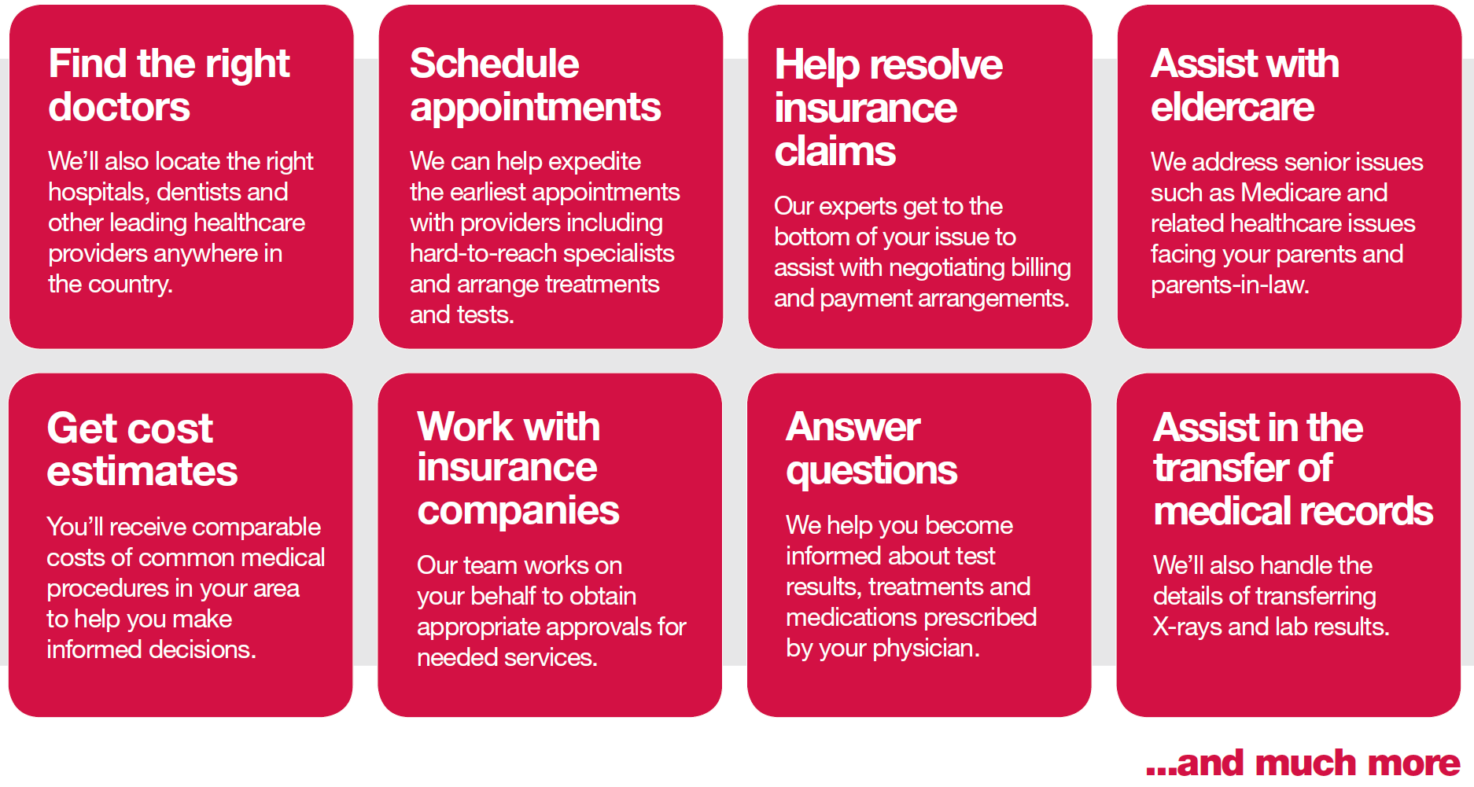
Health Advocate Resources
Available to all full-time employees, spouses, dependent children, parents and parents-in-law to assist with navigating benefit options and questions throughout the year

Slide 45
Thank You!

