Slide 1
July 1, 2023 Open Enrollment
Alera Group – Relph Benefit Advisors

Slide 2
Agenda
Open Enrollment Overview
Health Plan: Medical & Prescription Drug Coverage
NEW Optum Rx
Dental & Vision Plans
Flexible Spending
Life Insurance, Accidental Death & Dismemberment, & Long-Term Disability
Additional Voluntary Benefits
Health Advocate

Slide 3
Open Enrollment
Enroll in your benefits Wednesday, May 10 through Wednesday, May 24
Enrollments effective July 1, 2023
Only time of the year to:
Enroll in or Change Plans
(Re) Enroll in the FSA Plan
Add or Remove Dependents
Changes during the year are limited to qualifying events
& a 31-day window.

Slide 4
Health Plan Coverage

Slide 5
Medical Plan Overview
Meritain will continue for July 1, 2023
Independent company of Aetna
Members will continue to use the Aetna Choice POS II (Open Access) Network
Modest increase to deductible and out of pocket maximum
Visit providers without referral & PCPs are not required (but recommended)
Preventative Services Covered by the Plan
Well-Child Visits, Adult Physical (One/Contract Year)
Screening Mammography, Pap Tests,
Immunizations
Teledoc telemedicine program - $20 Copay for Acute Illnesses & Mental Health
Dependents Covered to Age 26

Slide 6
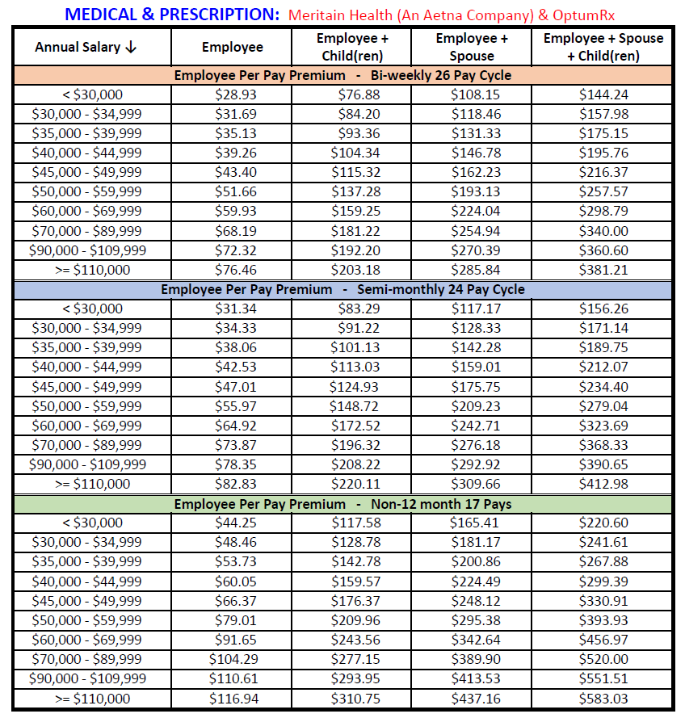
Medical Plan deductions effective
July 1, 2023

Slide 7
Aetna Choice POS II (Open Access) Minimal Plan Changes for July 1, 2023
Service | In-Network | Out-of-Network
Deductible | $500 Single $1,500 Family Tiers | $800 Single $2,400 Family Tiers
Coinsurance | Member pays 10%, after deductible | Member pays 30%, after deductible
Medical Out-of-Pocket Max | $1,500 Single / $4,500 Family Tiers | $1,950 Single / $5,850 Family Tiers
Primary Care | $20 copay, deductible waived | Deductible & Coinsurance
Specialist | $25 copay, deductible waived | Deductible & Coinsurance
Mental Health Office Visit | $25 copay, deductible waived | Deductible & Coinsurance
Diagnostic Labs | Deductible & Coinsurance | Deductible & Coinsurance
Inpatient Hospital | $200 copay, then 10% coinsurance after deductible | Deductible & Coinsurance
Urgent Care | $40 copay, deductible waived | Deductible & Coinsurance
Emergency Room | $125 copay, deductible waived | $125 copay, deductible waived

Slide 8
Meritain Member Portal
Website available to all enrolled members – Register now!
Review benefits and coverage
View and download claims
View Explanation of Benefits (EOBs)
Access benefit plan documents
Find a doctor
Access member ID cards
Register or log in at www.meritain.com

Slide 9
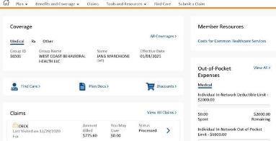
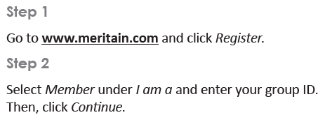
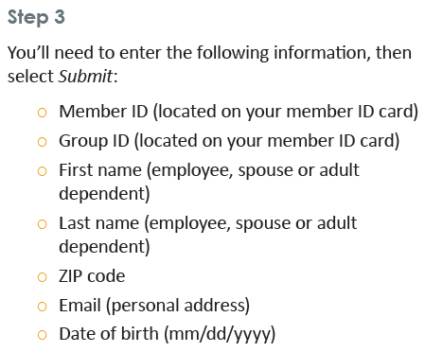
How to Register
You can access the portal by computer, tablet or via the Meritain Health mobile app on your iPhone® or Android™.

Slide 10
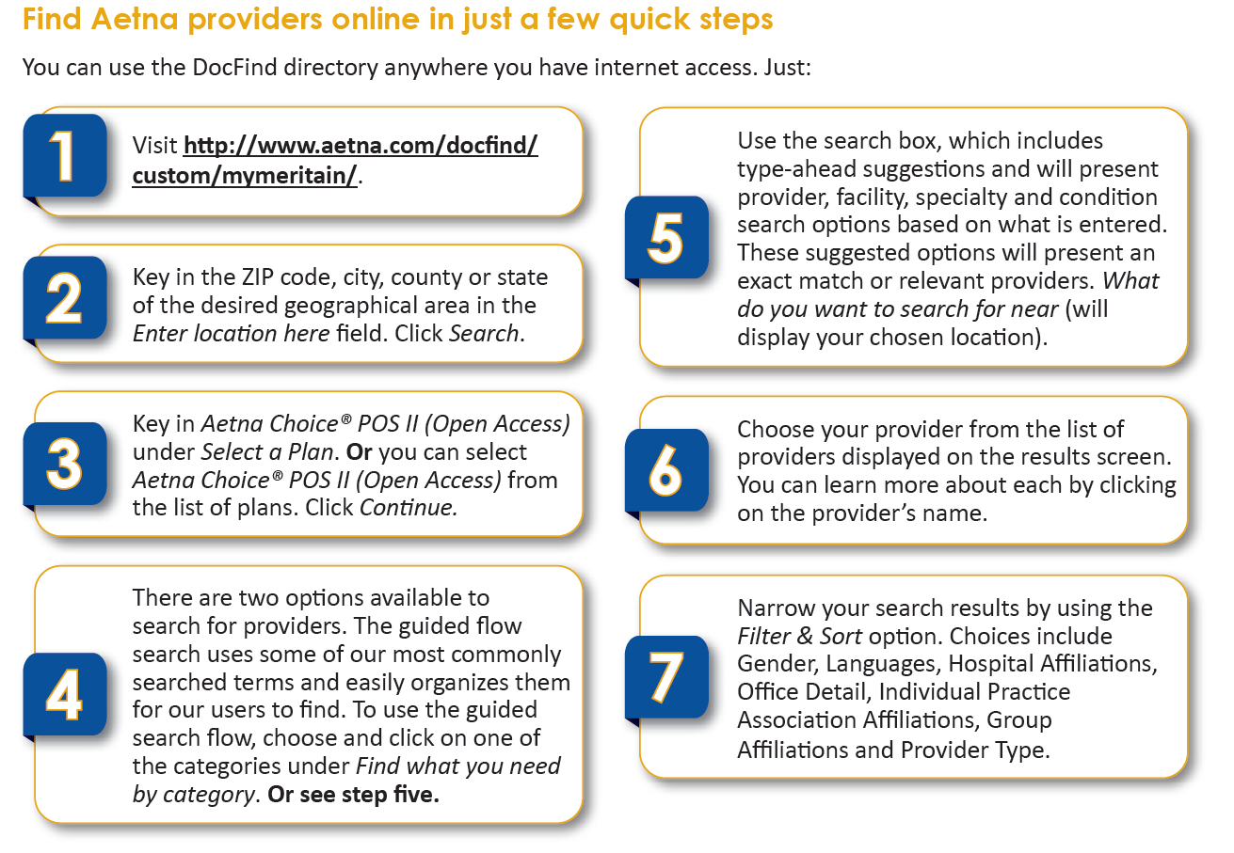
DocFind Provider Directory
*No Change to current provider network

Slide 11
Teledoc Telemedicine Program
Alternative to receive care by visiting a certified medical doctor right from your home, office or on the go for non-emergency medical conditions. Available 24/7/365
Physicians will diagnose your symptoms, prescribe medications (when appropriate) and send the prescription to your nearest pharmacy.
When to Use:
Primary care doctor is not available
Instead of going to the ER or Urgent Care (for a non-emergency)
Traveling and in need of medical care
Treatable Common Conditions:
Allergies, Asthma, Bronchitis, Cold/Flu, Diarrhea, Ear Infections, Fever, Headache, Infections, Insect Bites, Joint Aches, Rashes, Sinus Infections, Skin Infections, Sore Throat

Slide 12
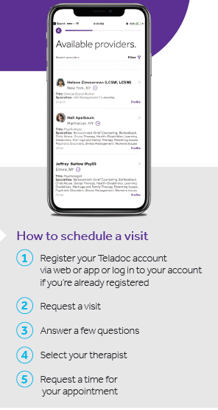
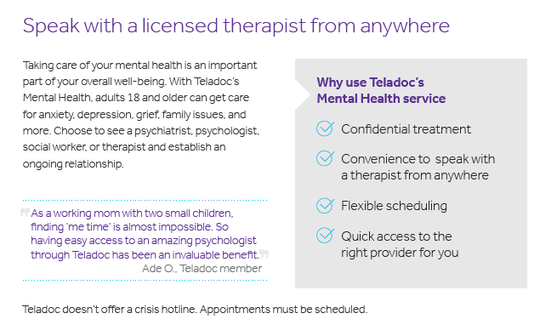
Behavioral Health on Teledoc “Confidential therapy on your terms”

Slide 13
Meritain Precertification
Meritain medical management team will help you get the most appropriate care, when and where you need it.
Precertify before the following:
Hospital admissions
Inpatient or outpatient surgery
IV home infusion therapy or chemotherapy
Inpatient substance abuse treatment
Home health care
Admission to an extended care or rehab care facility
Call before you get care
You or your doctor can call Meritain Health Medical Management to verify which procedures need to be precertified.

Slide 14
Additional Meritain Member Resources
Pre-Admission and Post-Discharge Counseling
Provides educations to members receiving inpatient procedures
Maternity Management
Connecting members with maternity nurse specialist (RN’s) for the duration of pregnancy
Institutes of Quality
Aetna network includes special network of hospitals and facilities known for providing quality care
Product Discounts
Meritain provides health discounts for healthcare products including blood pressure monitor and electrotherapy.

Slide 15
NEW Optum Rx Prescription Drug Plan
Dickinson College is joining the Preferred University Rx Purchasing Coalition (PURPC), a group of 40+ colleges & universities.
Optum Rx replaces CVS Caremark as the pharmacy vendor for claims processing, customer service, mail order & specialty.
NOTE - Fill your eligible prescriptions prior to 6/30/2023
Starting July 1, 2023
Member’s cost share remains the same
New ID numbers for pharmacy benefit, update your pharmacy after July 1
Member materials available;
Transitioning to Optum Rx FAQ
Formulary
Welcome kits & ID cards sent to homes in late June
www.optumrx.com, mobile apps for Apple & Android

Slide 16
Pharmacy Plan Details
Formulary is the list of medications covered by the plan. Updated twice per year based on latest research & clinical evidence. Copays are determined by the Tier.
Generics – Safe, effective & have the same active ingredients as a brand name medication, but cost an average of 85% less (brands with expired patents)
Preferred – Lower cost or more clinically effective than non-preferred or excluded
Non-Preferred – Highest cost or medications with clinical alternatives
Specialty – Complex medications purchased through a specialty pharmacy
Excluded – NEW TIER – Medications with clinical alternatives or generics that are not covered by the plan. Members must choose an alternative therapy.
Formulary – Online at Premium formulary (optumrx.com)
Members impacted by formulary changes & exclusions will receive letters directly from Optum Rx. Speak with your physician to avoid any interruptions in treatment.

Slide 17
Pharmacy Plan Details
Per the Formulary, medications may require treatment protocols including;
Quantity Limits – for safety & cost reasons, the plan limits the amount of drugs they cover over a certain period of time.
Prior Authorization – to be sure that medications are prescribed and used correctly, before the plan will cover a particular drug, your doctor or your prescriber must first show that you have a medically necessary need for that particular drug and/or have met the requirements for the drug.
Step Therapy – you must first try a less expensive drug on the formulary that has been proven effective for most people with your condition before you can move up a “step” to a more expensive drug. However, if you have already tried the more affordable drug and it didn’t work or if your prescriber believes that it is medically necessary for you to be on a more expensive drug, they can contact the plan to request an exception.
Specialty Prescriptions
Fill through Optum Specialty Pharmacy only, start the process prior to July 1 with your doctor to avoid any delays!
Ask about coupon programs to help cover your copays

Slide 18
Pharmacy Plan Details – 90 Day Supply
Mail Order
Purchase a 90-Day Supply – 2 copays, convenience of Auto Refill, the medication is sent automatically & Auto Renewal, Optum Rx renews your prescription with your doctor.
New service requires a minimum 90-day or annual script from your doctor
Provide home delivery pharmacy with…
Scripts (have your doctor e-scribe them directly)
Payment Method
Mailing Address
Retail Pharmacy
90-Day supply available at all participating retail pharmacies - 2 copays, convenience of Auto Refill & Auto Renewal, Retail pharmacy renews your prescription with your doctor.

Slide 19
Pharmacy Plan Details
Helpful Hints
Flu &/or Covid Vaccines in the Pharmacy – No Member Copay via Optum Rx coverage
Traveling Overseas – Plan ahead with scripts & a prior authorization for the length of travel plus return time
Diabetics – free meters available through Optum Rx program
If you are having any issues purchasing your medications, please contact Human Resource Services or Alera Group. We have access to Optum Rx service staff that are able to approve purchases, usually within 24-48 hours during the transition. We will need the patient, medication, dosage & the pharmacy details.
Need a refill as the patient & provider work through prior authorization
Need a refill of your existing script if step therapy is required
Need a refill as you transition to a new specialty pharmacy
Need a refill of an excluded medication as you speak with your doctor to transition to a new medication…and any other issues.

Slide 20
Medical and Rx ID Cards
Members will receive new Meritain ID Cards prior to July 1, 2023
Covered dependents are included on all cards
NEW Optum Rx information will be included on the Meritain ID Card
Please update your pharmacy with new ID Card information for July 1, 2023

Slide 21
DickinsonCRX Program
International mail order drug program
$0 copay for 90-day supply on certain brand name drugs
Visit http://www.dickinsoncrx.com/ for the full list of eligible medications and more information on the program
What is needed to enroll in the program:
Completed enrollment form
New prescription for each medication
Copy of photo ID

Slide 22
Dental Coverage

Slide 23
Dental Plan Overview
No Change in Plan Design or Employee Premiums for July 1, 2023
Dickinson College continues to offer two dental plans to benefit eligible employees and dependents
Dependent children covered to age 26
Find a provider at www.unitedconcordia.com
Dental network: Elite Plus
Create an account at www.unitedconcordia.com
Review coverage information
Check claim status
Print ID cards

Slide 24
Dental Per Pay Deductions

Slide 25
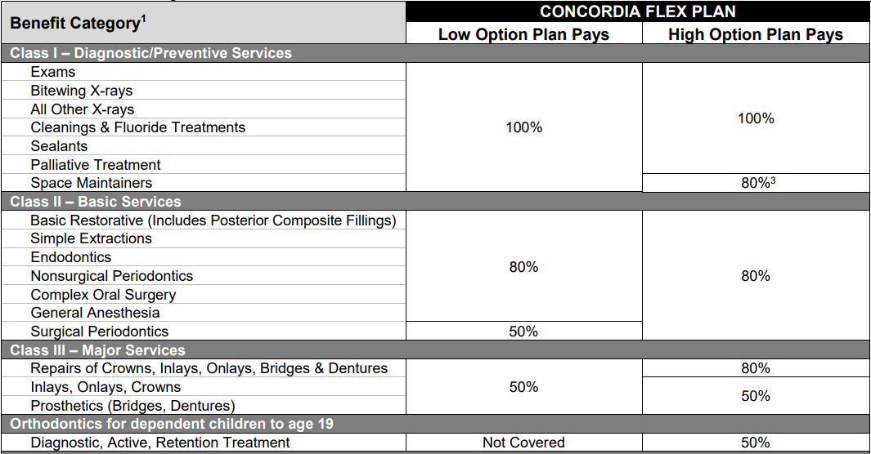

Slide 26
MyDentalBenefits Account
Creating an online account with United Concordia’s MyDentalBenefits gives you 24/7 access to information on your dental plan:
See your plan benefits
Check the status of claims and access EOB’s
Find a dentist near you
Chat live with customer service
Print ID cards

Slide 27
Vision Coverage

Slide 28
Vision Plan Overview
No Change in Plan Design or Employee Premiums for July 1, 2023
Dickinson College continues to offer vision coverage through Vision Benefits of America (VBA)
Dependent children covered to age 26
Log in to your vision member account at www.vbaplans.com
Find a participating provider to maximize your benefits
Access your eligibility for services
View your claim history and plan coverage
View/Print ID card, (card not necessary to access benefits)
Access out-of-network claim instructions
Vision services frequency
Routine exam – once every 12 months
Lenses – once every 12 months
Frames – once every 24 months

Slide 29
Vision Per Pay Deductions

Slide 30
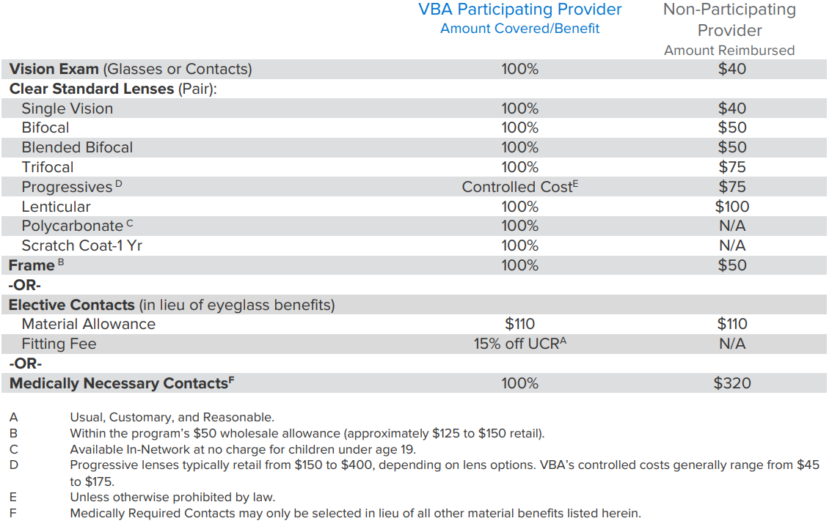
Vision Benefits

Slide 31
Flexible Spending

Slide 32
Flexible Spending Accounts (FSA)
Benefit MUST BE (re)elected every year!
Pre-tax dollars set aside to pay for health or dependent care expenses.
Accounts are “Use It or Lose It“ rule!
Check FSA store website for qualifying purchases – www.fsastore.com
Healthcare Spending Account (HCFSA)
$3,050 Annual Maximum
Benefit is fully funded July 1 if your expenses occur early in the year
Covers medical, Rx, dental & vision expenses for employee, spouse & children
Covers OTC and feminine hygiene products
Dependent Care Reimbursement Account (DCFSA)
Up to $5,000 “family” Annual Maximum (requires Tax ID# of provider)
*Grace Period to incur claims & use 2022-2023 flex money ends September 15, 2023. All claims MUST be submitted by October 31, 2023. Submissions MUST be dated prior to 9/16/2023.

Slide 33
HealthSmart Mastercard
Once enrolled in a Flexible Spending Account, members will receive a Benefits Mastercard from HealthSmart:
The card may be used to pay for eligible expenses under IRS guidelines, including:
doctor's visit and prescription drug co-pays
medical plan deductibles
eligible medical, dental or vision expenses that are not covered by any other plan.
dependent day care expenses (if dependent care account elected)
The card may be used to pay for eligible expenses at approved merchants that accept MasterCard
Expenses are limited to your elected annual maximum.
You must keep copies of all receipts for which you use your card. HealthSmart might request those receipts. If they are requested, and you fail to provide them, your card may be temporarily inactivated.

Slide 34
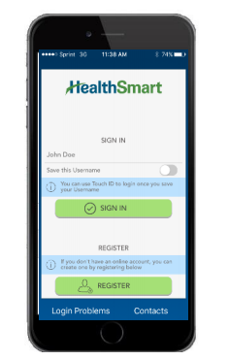
HealthSmart Member Portal and Mobile App
Create a HealthSmart online account at: https://healthsmart.wealthcareportal.com
Track balances
Access account history
Download forms
Mobile App
Search “myhealth for Healthsmart” in app store
File claims with camera-based receipt imaging
Get text alerts for balance and transaction inquiries

Slide 35
Life Insurance, Accidental Death & Dismemberment and Long Term Disability

Slide 36
Life Insurance and Accidental Death & Dismemberment (AD&D)
Core Benefit – Paid for by Dickinson College
Benefit eligible employees covered by Term Life and AD&D Insurance
Benefit amount of 3x salary to a maximum of $650,000 for FT Employees Hired Before January 1, 2008
Benefit amount of 2x salary to a maximum of $650,000 for FT Employees Hired On or After January 1, 2008
Age reduction applies at ages 65, 70, and 75
Voluntary Benefit – Term Life and AD&D Insurance
Evidence of Good Health required if enrolling after initial eligibility or for amounts greater than guaranteed issue coverage.
Employees may elect increments of $10,000 to a maximum of $300,000. Age reduction applies at ages 65, 70, and 75.
Spouse may elect $10k to lesser of $150k or 50% of employee amount
Children to age 26, may elect increments of $2,500 to a maximum of $10,000

Slide 37
Long-Term Disability
Paid for by Dickinson College
Provided to benefit eligible employees
Benefits begin after 180 days of disability.
60% of base monthly earnings to a max of $10,000 per month.
Payable to normal social security retirement age.

Slide 38
Voluntary Benefit – Accidental Death & Dismemberment (AD&D)
Additional accidental death and dismemberment coverage available to benefit eligible employees through The Hartford
Elect $10,000 to $300,000 in coverage
Any amount over $150,000 cannot exceed 10x salary
Age reduction applies at ages 65 and 70

Slide 39
Additional Voluntary Benefits

Slide 40
Accident and Critical Illness
Personal Accident Indemnity Plan
Accident Emergency Treatment
Accident Follow-up Treatment
Hospitalization Benefit; Initial, Confinement, ICU
Major Diagnostic Exams
Physical Therapy
Accidental Death & Dismemberment
Wellness Benefit, $60/year per participants (after 12 months of coverage)
Critical Illness Coverage
Covered Illnesses include: cancer, heart attack, stroke, major organ transplant, renal failure, coronary bypass
Wellness Benefit, $50/year per participant
Please visit https://www.aflacenrollment.com/DickinsonCollege/177915123144
for more information and to enroll in coverage

Slide 41
Home and Auto Insurance
Voluntary benefit offered to full-time employees at group-discounted rates
Coverage premiums paid through payroll deductions
100% portable - you take the coverage with you!
Options available:
Home Boat Motor Home
Auto Condo Motorcycle
Personal Excess Liability Renter’s Recreational Vehicle
Call 1-800-438-6381 for more information or a free quote.

Slide 42
Long Term Care Insurance
Provides coverage for expenses on long term care services received at home, in the community or in a nursing facility.
Eligibility:
Maintain a permanent US residence and have a valid Social Security Number or Tax Identification Number from the US government.
Actively at work, full-time (35 hours per week) employees
Employee's spouse under age 76
Employee's Parents and Parents-in-law under age 76
Employee's Grandparents and Grandparents-in-law under age 76
Employee's or spouse's Adult Children and Siblings under age 76
Enroll Now!
Go to: www.genworth.com/dson
Or call 800-416-3624
All members are direct billed by Genworth.

Slide 43
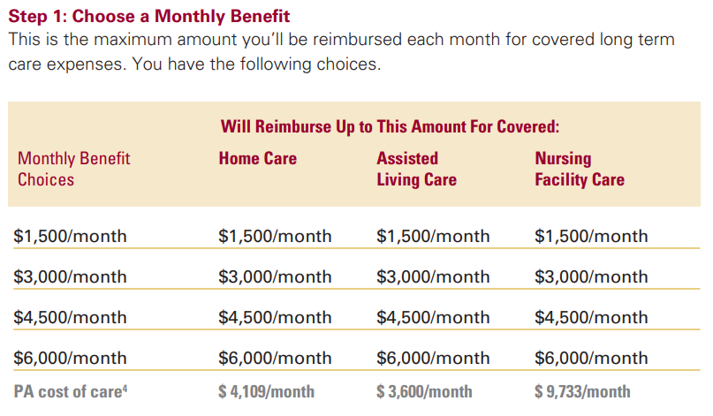
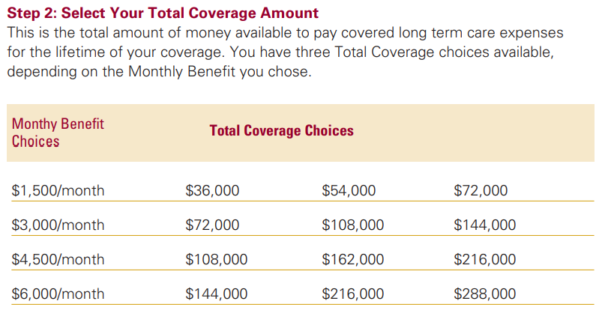
Genworth Long Term Care Options

Slide 44
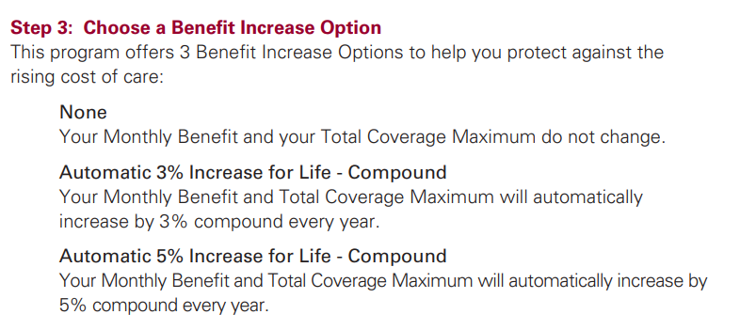
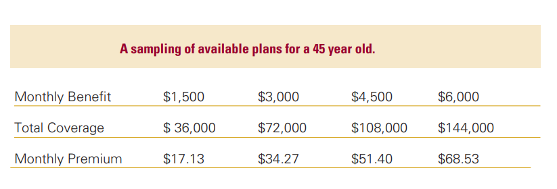
Genworth Long Term Care Options

Slide 45
Health Advocate

Slide 46
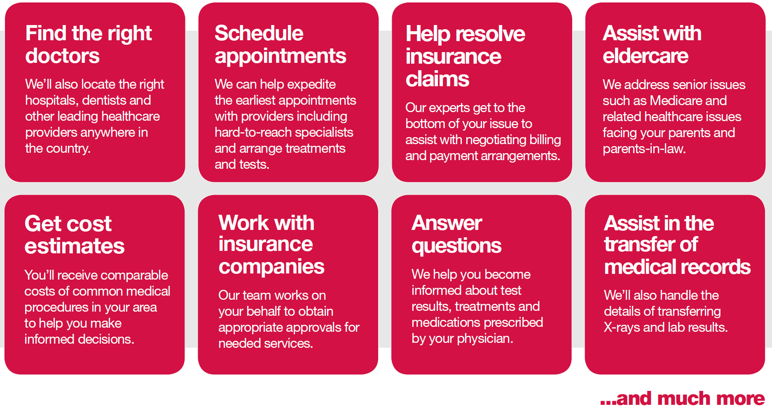
Health Advocate Resources
Available to all full-time employees, spouses, dependent children, parents and parents-in-law to assist with navigating benefit options and questions throughout the year

