Slide 1
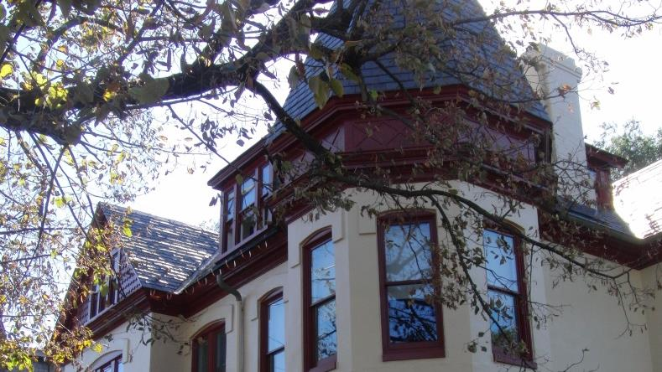
La Casa de Lenguas Romances
¡Bienvenidos!

Slide 2
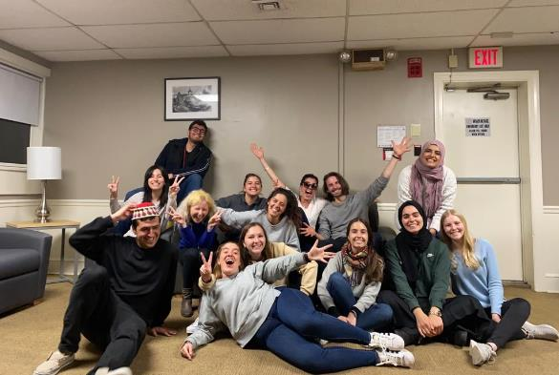
Welcome to the
Casa de Lenguas Romances!

Slide 3
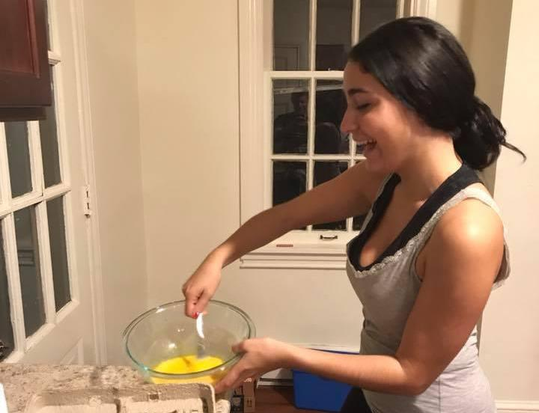
What’s in the
kitchen?
Whipping up a tortilla española

Slide 4
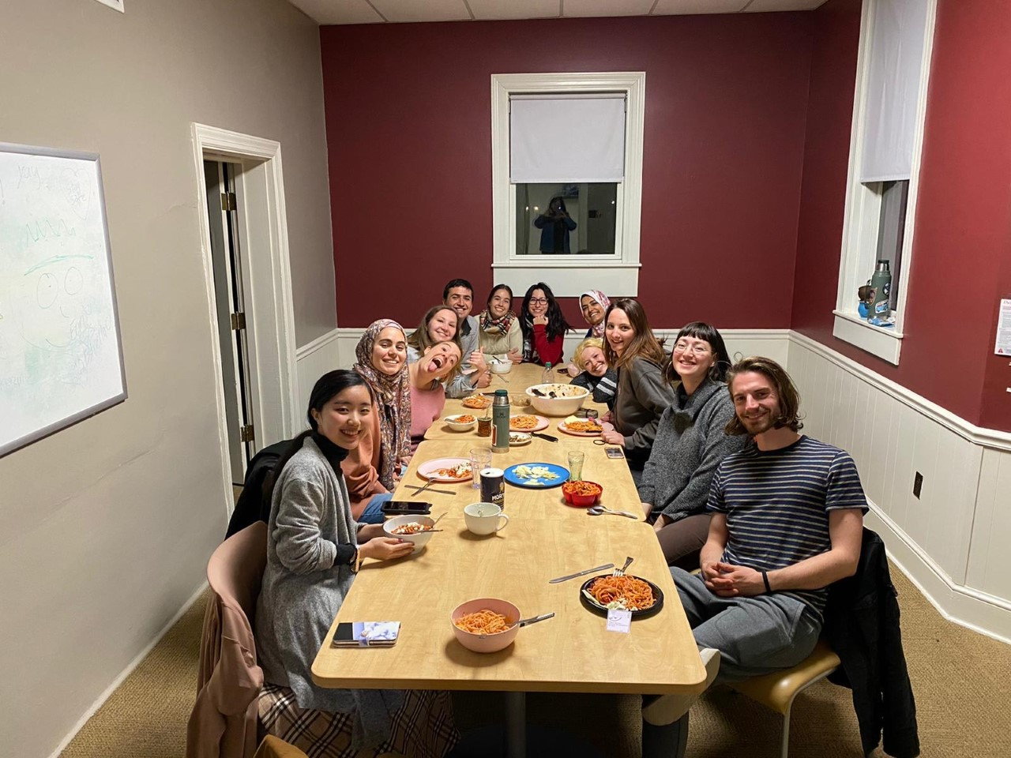
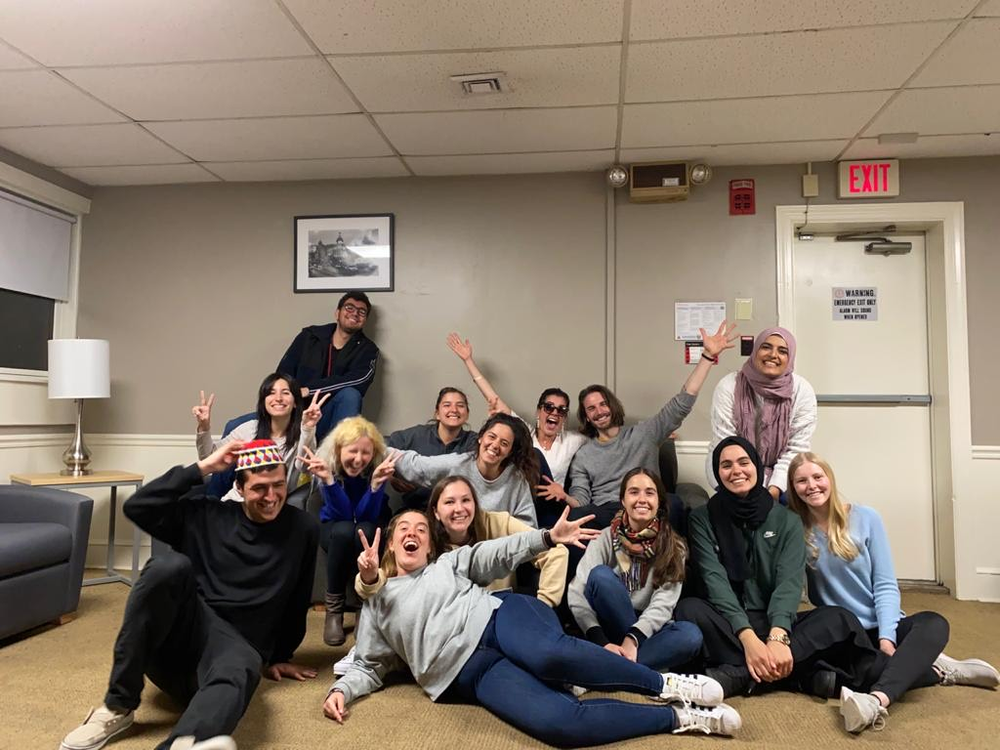
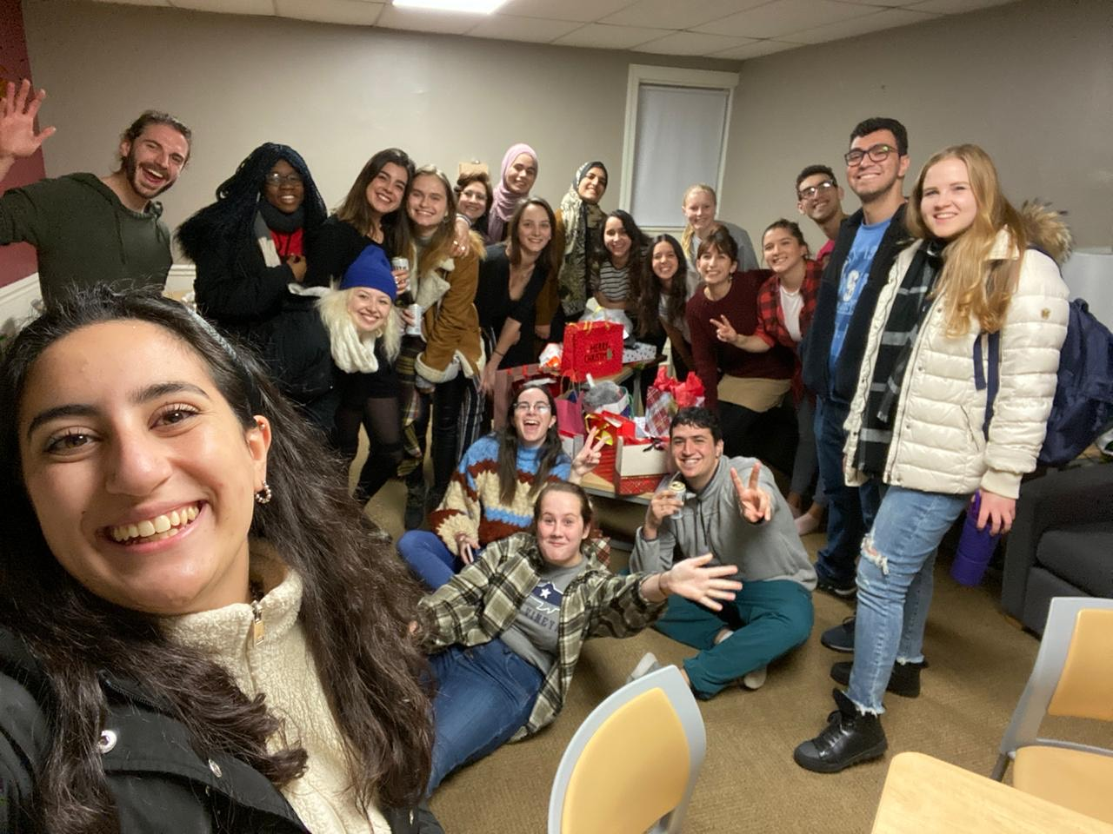
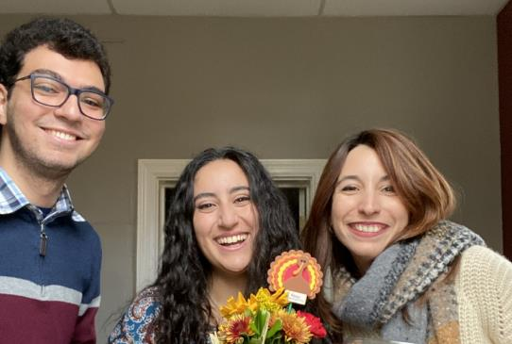
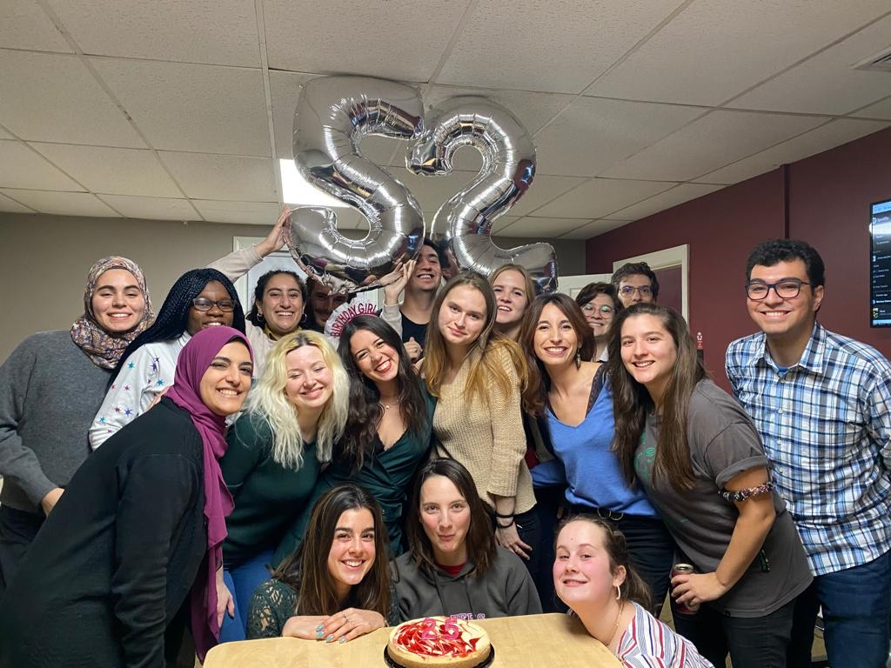
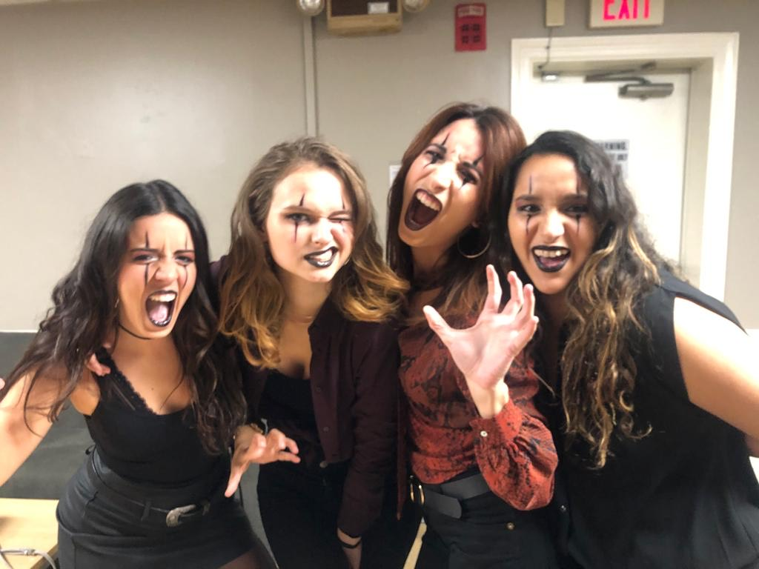
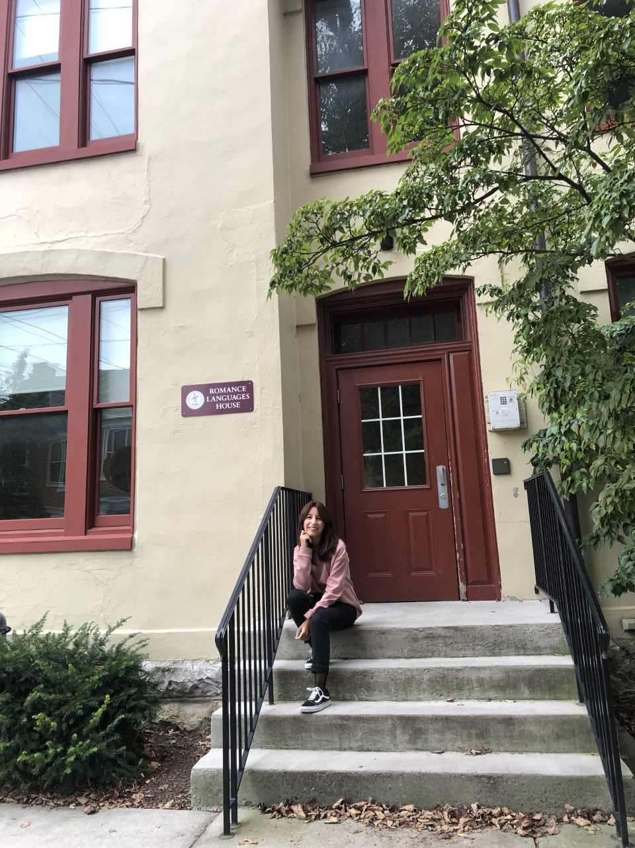
Holiday celebrations

Slide 5
El Día de
los Muertos
Making papel picado for the altar

Slide 6
Julia Chandler (Class of 2022)
“I am grateful to have had the opportunity to live in the Romance Language House because being there brought me to the center of our campus’ foreign language culture. I had every opportunity to engage with both native speakers and students of the language I study. Oftentimes, I didn’t even need to leave my living room to find an activity or event designed to bring together speakers of a language I love.”

Slide 7
Your seat at our table awaits!

Slide 8
Apply now to join us!

