Slide 1
Dickinson College Budget Training
Using Banner Self-Service

Slide 2
Banner Self Service
Please review “Budgeting Fundamentals” prior to using Banner Self-Service for the first time.
The concepts and information in this companion training document will help you to successfully negotiate and understand the query results in Banner Self-Service.

Slide 3
Banner Self-Service: Logging In
Banner Self Service Application Through the Gateway

Slide 4
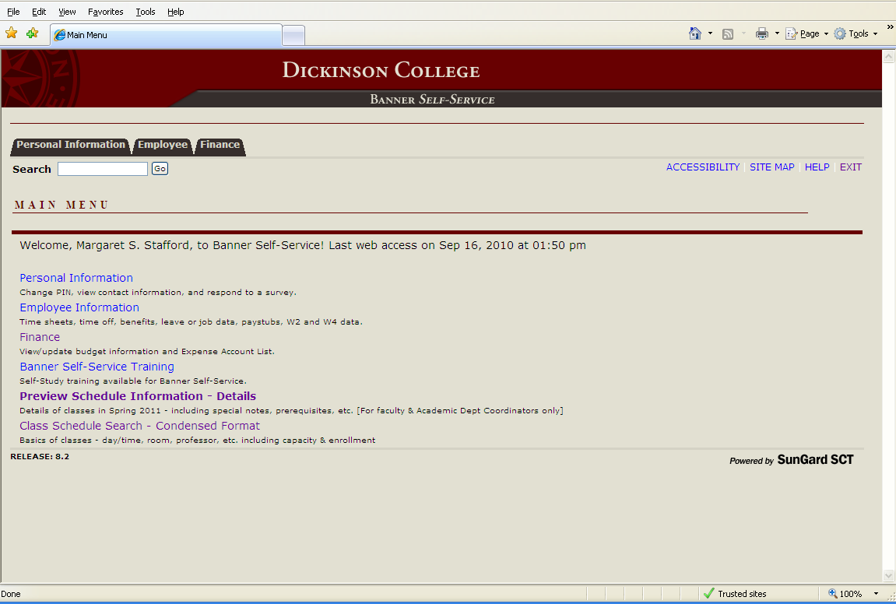
Banner Self-Service: Logging In

Slide 5
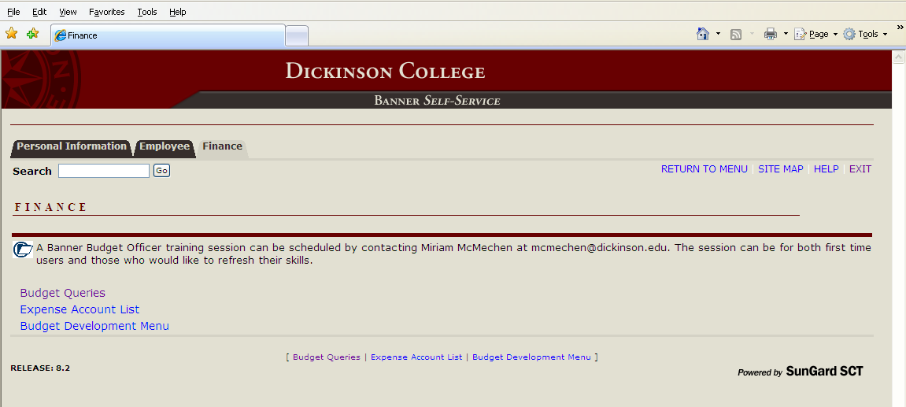
Banner Self-Service: Logging In
Budget Queries – query current or past budgets
Expense Account List – list of available expense account codes for reference
Budget Development Menu - input future budget (used in the spring) See separate training
manual.

Slide 6
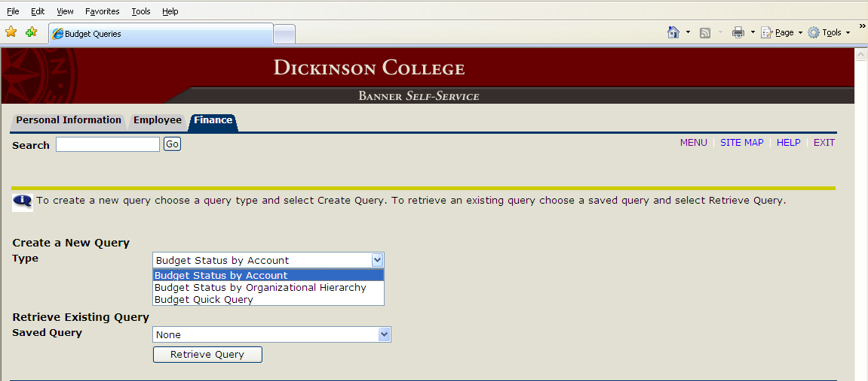
Banner Self-Service: Query
Three Query Types via drop-down box:
Budget Status by Account – build custom query with drill down capabilities – recommended
Budget Status by Organizational Hierarchy – useful for those who monitor several budgets in a hierarchical structure
Budget Quick Query – defaults built in, but no drill down or download capabilities
Page includes ability to retrieve an previously saved query, as well.

Slide 7
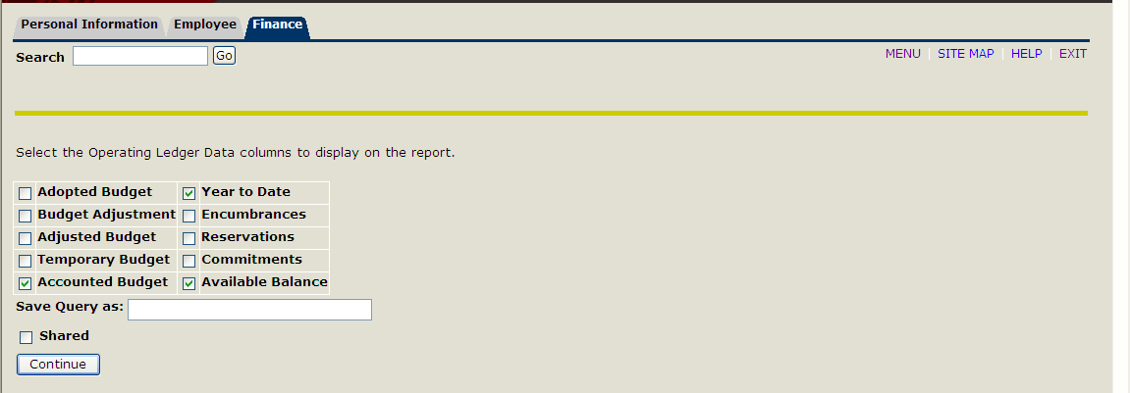
Banner Self-Service: Query
Column selection for query.
Dickinson College currently uses “Adopted Budget” and “Temporary Budget” codes.
“Accounted Budget” is the sum of budget categories, and so is your total available budget.
“Year to Date” is fiscal year’s revenue, expenses, and transfers to date of the query
“Available Balance” is “Accounted Budget” minus “Year to Date”
“Encumbrances” list open Purchase Orders.
Dickinson College does not use “Reservations.”
“Commitments” is the sum of “Encumbrances” and “Reservations.”

Slide 8
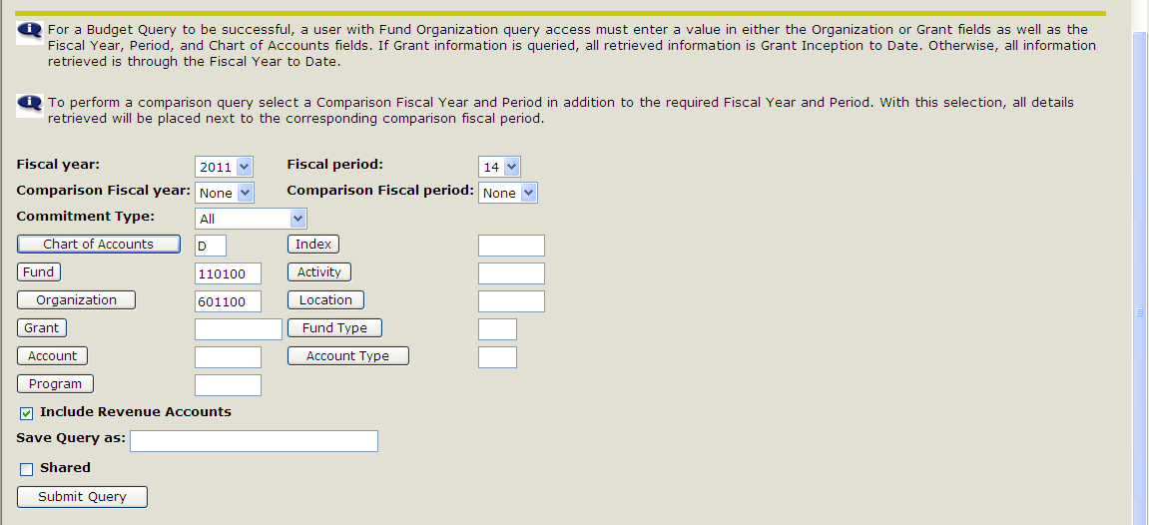
Banner Self-Service: Query
To generate a query, you must input:
Fiscal Year
Fiscal Period (01=July, 02=August, 03=September, etc.)
Chart of Accounts: Enter “D” for Dickinson
Fund
Organization
Note the following:
“Commitment Type” field defaults to “All”
Check “Include Revenue Accounts” checkbox if you want to retrieve revenue data

Slide 9
Banner Self-Service: Query
Query Tips:
Entering Fund and Organization (no account, program, activity, or location) allows you
to query all account lines in your budget and get bottom line budget totals.
Data is cumulative within the fiscal year. Inputting Fiscal Period “01” will give you data from July; however, inputting “Fiscal Period “02” will give you July and August data. This reporting tool does not have the functionality to give you a snapshot of one month (other than July.)
All choices inputted into fields will remain until changed. When you return to the tool
next time, the fields will be populated with the choices made in last query.
Since it is easy to forget to change the “Fiscal Period” field, we recommend inputting “14”. (“14” is the accrual period – entries made after the year close.) This choice will pull all the data to date throughout the year.
To query only your Student Wage Budget lines, input “6%” in the “Account” field. To query only your Operating Budget lines, input “7%” in the “Account field. (Note of Caution: If you have any transfers,“8’s”, against your operating budget, you will need to query those separately with “8%” and add them to or subtract them from the results of your “7%” query.
Activity Codes allow one to track a program or event within a larger budget. Enter Fund, Organization, and Activity numbers to query on all account lines.

Slide 10
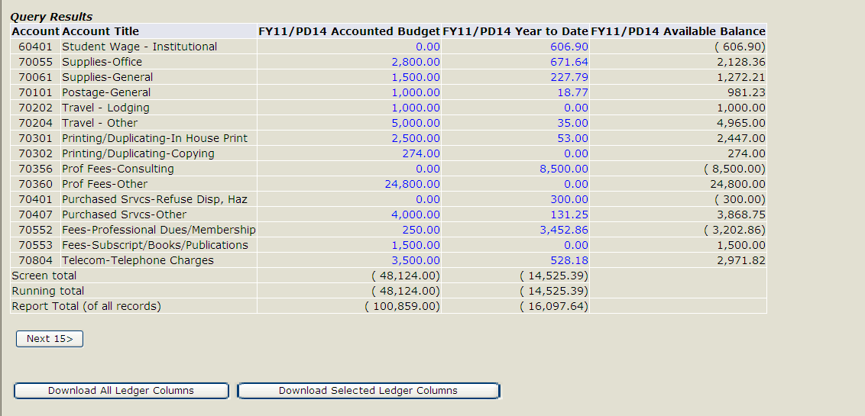
Banner Self-Service: Query Results
Sample Operating Budget Query – recommended columns
Indicates that page cannot display all account lines
If not all lines display on one page, the following Totals rows will appear: “Screen total” = total for rows currently displayed on screen.
“Running total” = total for pages you have clicked through. For example, if your lines are displayed across 3 pages and you are displaying page 2, then the running total will equal the sum of page 1 plus page 2.
“Report total (of all records)” = sum for all pages in the query regardless of the page you are displaying.

Slide 11
Banner Self-Service: Query Results
Any number that is “blue” is an active link with drill down capabilities to retrieve more detail.
Results
Click here for detail
Detail:

Slide 12
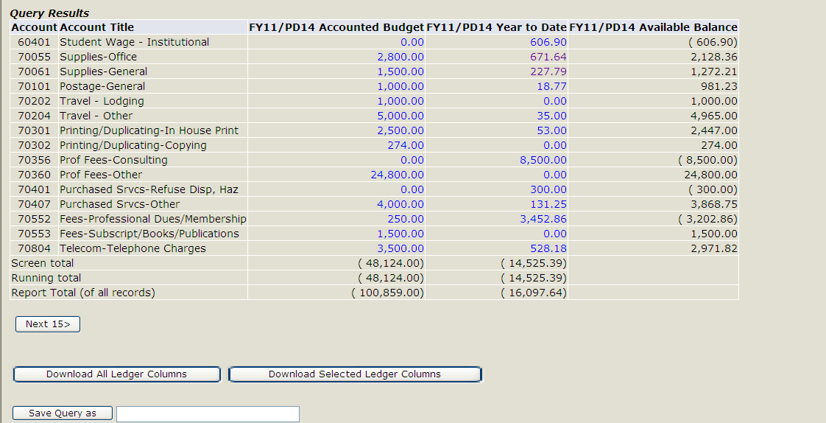
Banner Self-Service: Download
Download data to Excel Spreadsheet.
Option 1: Download Selected Ledger Columns – downloads columns you selected for the query and are currently displayed - recommended
Option 2: Download All Ledger Columns – downloads all possible columns even if not
selected for current display. (All choices listed on page with checkboxes.)
Tip: Spreadsheet will need some formatting to make a presentable report.

Slide 13
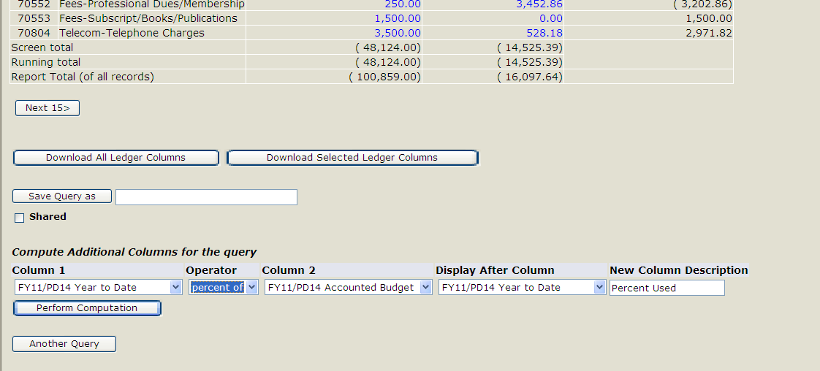
Banner Self-Service: Computation
Example: Add column that shows percent of budget used to date.
Column 1: Select “FY11/PD14 Year to Date”
Operator: Select “percent of”
Column 2: Select “FY11/PD14 Accounted Budget
Display After Column: Select “FY11/PD14 Year to Date”
New Column Description: “Percent Used”
Click “Perform Computation” button
Results on next slide.

Slide 14
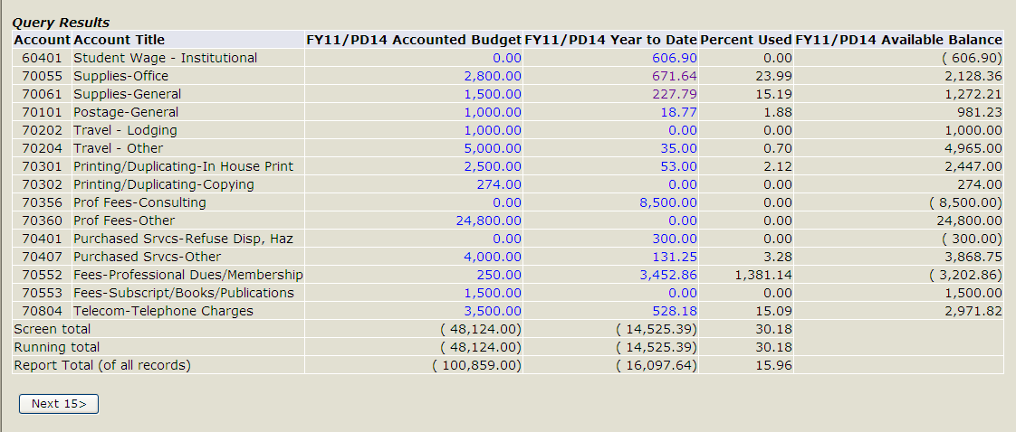
Banner Self-Service: Computation
Example: 23.99% of
budget has been used to date in this line
Note: If no budget exists in a line, “0.00” will display when actually the line is over budget.
Computation column can be removed with “Remove Computation” button. Other computation options are available in drop-down box.

Slide 15
Banner Self-Service: Sample
Sample: Operating Budget
Account | Account Title | Acounted Budget | Year to Date | Available Balance
60401 | Student Wage-Institutional | 3,132.00 | 4,036.87 | (904.87)
60402 | Student Wage-FWS | 1,218.00 | 1,075.64 | 142.36
70055 | Suppplies-Office | 9,142.00 | 9,336.07 | (194.07)
70061 | Supplies-General | 1,670.00 | 1,868.96 | (198.96)
70101 | Postage-General | 13,363.00 | 11,086.12 | 2,276.88
70153 | Entertainment/Receptions/Banquets | 1,038.00 | 478.12 | 559.88
70155 | Meals-Dining Service | 34.00 | - | 34.00
70201 | Travel-Transportation | 980.00 | 718.62 | 261.38
70202 | Travel-Lodging | 1,397.00 | 2,372.09 | (975.09)
70203 | Travel-Meals & Entertainment | 313.00 | 562.76 | (249.76)
70204 | Travel-Other | 3,314.00 | 410.28 | 2,903.72
70301 | Printing/Duplicating-In-House Pring | 3,573.00 | 4,325.05 | (752.05)
70302 | Printing/Duplicating-Copying | 1,925.00 | 3,469.92 | (1,544.92)
70360 | Prof. Fees-Other | 4,527.00 | 3,882.82 | 644.18
70551 | Fees-Conference/Meeting/Seminar | 2,573.00 | 3,023.00 | (450.00)
70552 | Fees-Professional Dues/Membership | 1,476.00 | 1,229.95 | 246.05
70553 | Fees-Subscript/Books/Publications | 4,335.00 | 1,410.92 | 2,924.08
70504 | Telcom-Telephone Charges | 1,550.00 | 1,017.14 | 532.86
70903 | Misc. Expense-Other | 355.00 | 497.07 | (142.07)
72401 | Furniture | - | 614.51 | (614.51)
 | TOTALS | (55,915.00) | (51,415.91)
Student Wages 6’s
Operating Expenses 7’s
Determine amount available to spend by subtracting Year- to-Date from Accounted Budget
Budget
Expenses to date
Budget minus Year-to-Date

Slide 16
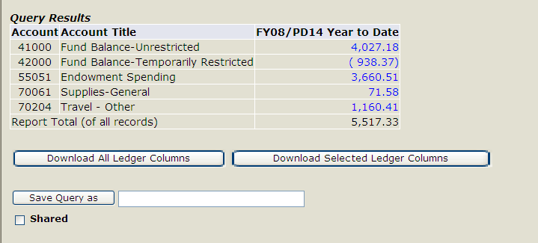
Banner Self-Service: Sample
Only column necessary in query
Sample: Restricted Fund
is “Year to Date”
Add “4’s” together to get beginning fund Balance
Revenue-5’s-add to Fund Balance
Expenses-7’s-subtract from Fund Balance Available Funds
Tip: You must have “Include Revenue Accounts” checkbox checked to see “Fund Balance” account lines.
Remember that payroll (other than student payroll) does not show in Banner Self-Service. If you know that payroll is being paid from a restricted fund, please contact the Budget Office for that information and to obtain your true Report Total.

Slide 17
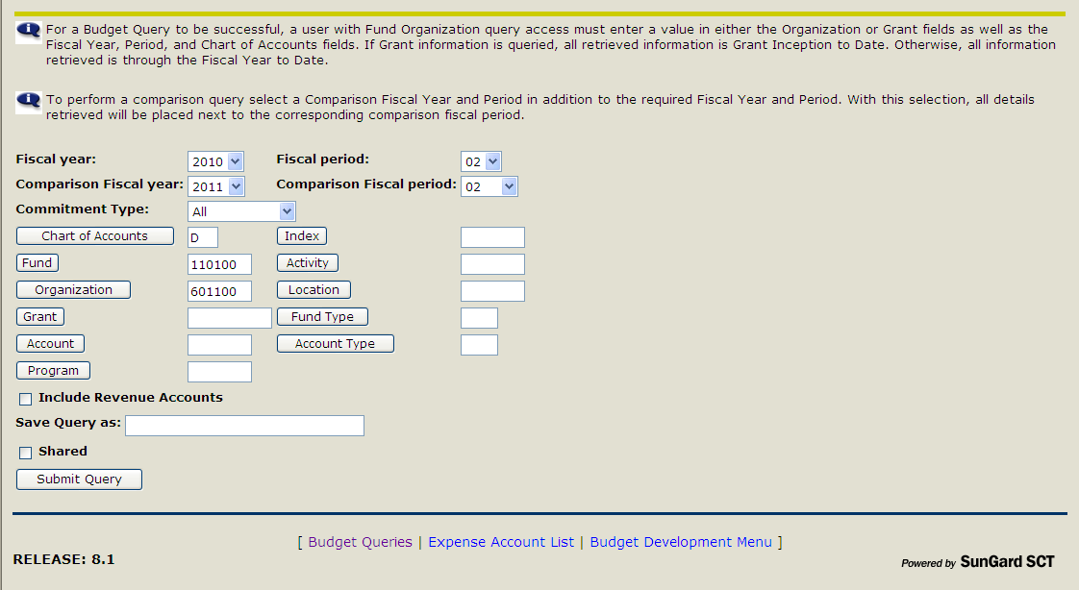
Banner Self-Service: Compare Years
Example: Compare Budget and Year-to-Date for FY11 and FY11 as of end of August (period 02). Results on next slide.

Slide 18
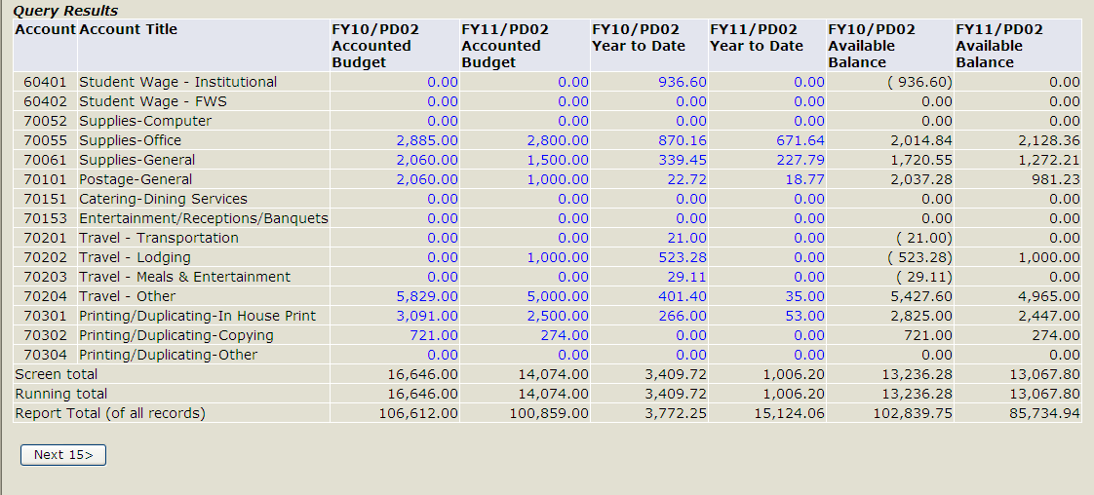
Banner Self-Service: Compare Years
Sample Operating Budget: Comparing FY11 to FY10, end of August
FY10 Budget compared to FY11
FY10 Year to Date compared to FY11

