Slide 1
“I can’t watch another one of those videos”: Racial violence, trauma, and healing
Vincent L. Stephens, Ph.D.
&
Missy Taylor, Ph.D.

Slide 2
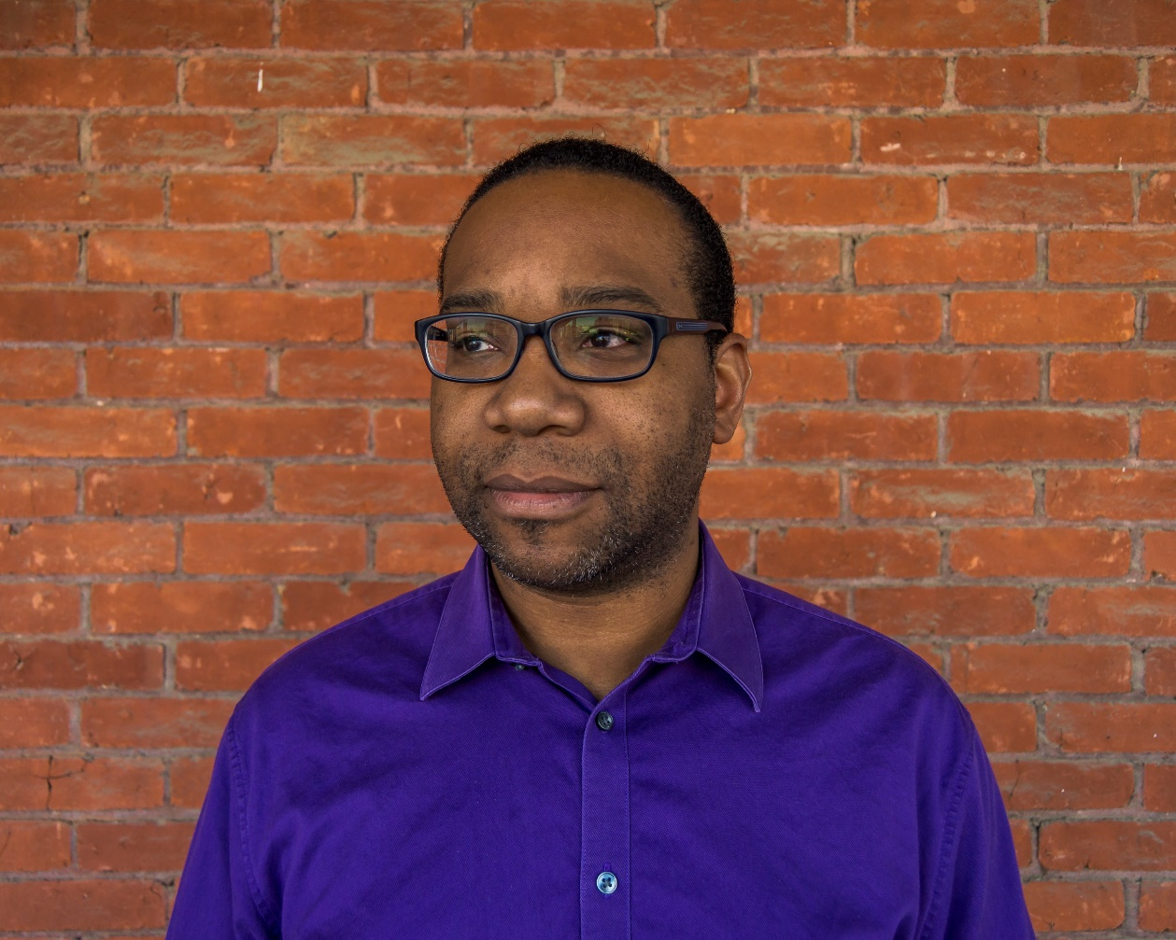
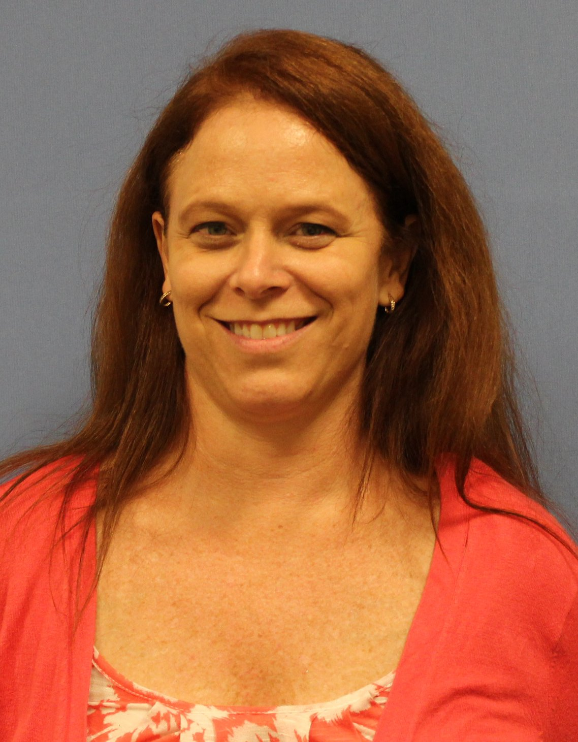
Vincent L. Stephens, Ph.D.
Director,
Popel Shaw Center for Race & Ethnicity
Contributing Faculty, Department of Music
Dr. Missy Taylor
AOD Coordinator/Licensed Psychologist
Wellness Center

Slide 3
Goals and Outcomes
Increase awareness of the proliferation of viral videos depicting various forms of violence against people of color
01
Offer students opportunities to reflect on experiences at Dickinson with racial violence
02
Develop an understanding of the mental impact of prolonged exposure to these images
03
Identify some common mental/emotional effects student activists might experience
04
Understand the nature of trauma and triggers
05
Learn different ways to manage the impact of racial trauma
06

Slide 4
Format and Structure
Welcome
Why is this important
Student reflections
Defining trauma and racial trauma
Impact of racial trauma
How to cope/next steps
Wellness Center information & invitation for future engagement

Slide 5
Why is this important?
The circulation of viral videos has increased national awareness of racialized violence and police brutality and viewing them can also traumatize viewers.
We want to help you understand the mental impact of these disturbing images, recognize trauma and triggers, and learn different ways to manage the impact of racial trauma.

Slide 6
Student Reflections
Think about
Think about your exposure to racial violence, whether experienced personally or observed (i.e., can include TV or social media)
Write down
When you think about these experiences, write down what thoughts and feelings come up for you
Write down
Briefly write down how you have responded to those thoughts and feelings in the past
Reflect
Reflect upon what you think about how you've dealt with your thoughts and feelings in reaction to racial trauma

Slide 7
What is trauma?
“Trauma is an emotional response to a terrible event like an accident, rape or natural disaster. Immediately after the event, shock and denial are typical. Longer term reactions include unpredictable emotions, flashbacks, strained relationships and even physical symptoms like headaches or nausea.” https://www.apa.org/topics/trauma/
The emotional reaction is caused by neuroscience. Your autonomic nervous system is made of the sympathetic and parasympathetic nervous system. These trigger the following responses: Fight, flight, or freeze,
Your responses to trauma are normal reactions to an abnormal event or series of events (chronic). Anger, depression, anxiety, nightmares, physical reactions, being easily startled and hypervigilant, etc. are common reactions to trauma.

Slide 8
Racial Trauma
Racial trauma refers to experiences of racial discrimination such as shaming or embarrassing events, threats of harm and injury, and witnessing harm to others due to racism http://dx.doi.org/10.1037/amp00004421 (p. 1)
Common symptoms of racial trauma include chronic stress and negative emotions, hypervigilance and suspiciousness, flashbacks/re-experiencing, avoidance, nightmares or sleep problems, and physical problems like headaches, heart problems, hypertension, etc. (PTSD?)

Slide 9
Coping with Racial Trauma
Connect with others with whom you can have racially conscious conversations. Process your thoughts and emotions with others.
Self-care (treat yourself!)
Mindfulness and/or spirituality
Recognize symptoms of racial trauma and do not internalize blame
Limit exposure to news and social media
Activism

Slide 10
Wellness Center Resources
We are open 8:30-4:30 M-F
Call us at 717-245-1663 to schedule an appointment to speak with a counselor
If in crisis, call 911 if off campus or call DPS if on campus
We provide counseling, health services, nutrition services, and psychiatry
Counseling services are free and confidential
If you don’t feel like you connect with your counselor, please ask to meet with another therapist

Slide 11
Resources
https://www.dickinson.edu/homepage/138/wellness_center
https://psychology.uga.edu/coping-racial-trauma
https://www.alexandriava.gov/dchs/adultservices/default.aspx?id=116118
https://www.calltomindnow.org/spotlight-on-black-trauma-and-policing

