Slide 1
Faculty Salary Study
March 7th and 9th 2023
Jeffrey S. Forrester
Sarah Niebler

Slide 2
Overview of the Salary Data Set
Data was provided for 186 individuals spanning hiring dates 1981-2022.
Counts by Rank, Division, and Gender:
Gender
Rank F M
Assistant 24 22
Associate 46 36
Professor 21 37
Gender
Division F M
1 42 25
2 28 43
3 21 27
Assistant (46)
Gender
Division F M
1 10 3
2 7 15
3 7 4
Associate (82)
Gender
Division F M
1 20 16
2 16 15
3 10 5
Professor (58)
Gender
Division F M
1 12 6
2 5 13
3 4 18

Slide 3
Overview of the Salary Data Set
Average Salary by Rank, Division, and Gender:
Assistant
Div F M Δ
1 79770 79567 194
2 81629 83527 -1898
3 83529 82650 879
Associate
Div F M Δ
1 88715 91600 -2885
2 89794 91227 -1433
3 90760 96260 -5500
Professor
Div F M Δ
1 107575 107150 425
2 117460 118462 -1002
3 107950 111867 -3917
Assistant Associate Professor
F 81408 89535 110000
M 82827 92092 113419
Δ -1419 -2557 -3419
The Δ row or column represents the cell difference F_Average − M_Average
This is where it looks like there is a gender disparity in pay. At each rank, women earn less than men.
Is this difference statistically significant?

Slide 4
Modeling the Salary Data Set
Linear Model of Salary by Rank and Gender:
Assistant Associate Professor
F 81408 89535 110000
M 82827 92092 113419
Δ -1419 -2557 -3419
lm(formula = S_22 ~ Rank + Gender, data = Faculty_DF2)
Residuals:
Min 1Q Median 3Q Max
-22295 -4748 -1488 2514 41429
Coefficients:
Estimate Std. Error t value Pr(>|t|)
(Intercept) 80880 1599 50.573 < 2e-16 ***
RankAssociate 8669 1800 4.816 3.07e-06 ***
RankProfessor 29691 1942 15.287 < 2e-16 ***
GenderM 2523 1455 1.734 0.0845 .
---
Signif. codes: 0 ‘***’ 0.001 ‘**’ 0.01 ‘*’ 0.05 ‘.’ 0.1 ‘ ’ 1
Residual standard error: 9767 on 182 degrees of freedom
Multiple R-squared: 0.6052, Adjusted R-squared: 0.5987
F-statistic: 93 on 3 and 182 DF, p-value: < 2.2e-16
We observe a marginally significant gender effect at this level of modeling with coefficient Male = +2523. However, the p-value of p=0.0845 only suggests some evidence of an effect. No interactions between Gender and Rank were identified.
This model explains about 60% of the variability in the salary data. What other variables are important in explaining salaries?

Slide 5
Overview of the Salary Data Set
The variables yearsemployed: years employed at Dickinson; and
endowedchair: 1 – individual holds an endowed chair, 0 – no endowed chair
were added to the model. Summary of these variables:
Years Employed
Endowed Chair
Assistant
Div F M Δ
1 79770 79567 194
2 81629 83527 -1898
3 83529 82650 879
Associate
Div F M Δ
1 88715 91600 -2885
2 89794 91227 -1433
3 90760 96260 -5500
Professor
Div F M Δ
1 107575 107150 425
2 117460 118462 -1002
3 107950 111867 -3917
Assistant
Div F M Δ
1 5.0 5.0 0.0
2 3.7 2.5 1.2
3 3.6 2.0 1.6
Associate
Div F M Δ
1 13.7 15.9 -2.2
2 12.8 15.5 -2.7
3 14.0 20.0 -6
Professor
Div F M Δ
1 24.6 23.3 1.3
2 25.8 27.2 -1.4
3 23.8 24.6 -0.8
Assistant
Div F M
1 1 0
2 0 1
3 0 0
Associate
Div F M
1 1 0
2 1 0
3 1 0
Professor
Div F M
1 4 0
2 3 7
3 0 5

Slide 6
Modeling the Salary Data Set
Full Model:
lm(formula = S_22 ~ I(yearsemployed^2) + yearsemployed + Rank + Division + Gender + endowedchair, data = Faculty_DF2)
Residuals:
Min 1Q Median 3Q Max
-16801.3 -2341.3 -488.1 2130.2 13400.2
Coefficients:
Estimate Std. Error t value Pr(>|t|)
(Intercept) 80763.931 1015.336 79.544 < 2e-16 ***
yearsemployed^2 37.903 3.838 9.875 < 2e-16 ***
yearsemployed -391.736 173.634 -2.256 0.02529 *
RankAssociate 4251.445 1340.580 3.171 0.00179 **
RankProfessor 11580.796 1758.886 6.584 5.02e-10 ***
Division2 2218.437 751.722 2.951 0.00359 **
Division3 1805.193 822.970 2.194 0.02957 *
GenderM 497.711 648.396 0.768 0.44375
endowedchair 6409.423 1033.298 6.203 3.81e-09 ***
---
Signif. codes: 0 ‘***’ 0.001 ‘**’ 0.01 ‘*’ 0.05 ‘.’ 0.1 ‘ ’ 1
Residual standard error: 4221 on 177 degrees of freedom
Multiple R-squared: 0.9283, Adjusted R-squared: 0.925
F-statistic: 286.4 on 8 and 177 DF, p-value: < 2.2e-16
In the presence of the variables yearsemployed and endowedchair (and Rank and Division), the observed gender effect is not significant.
The modeled value is Male = +498. However, the p-value for the coefficient differing from 0 is 0.444, suggesting that the difference of ~$500 could have arisen by random fluctuations alone.
This model explains about 93% of the variability in the salary data.

Slide 7
Model Diagnostics
After the removal of one data point with a large residual, the model was refit producing the following diagnostic plots. Conclusions from the previous model were similar. These diagnostic plots support the aptness of the model.

Slide 8
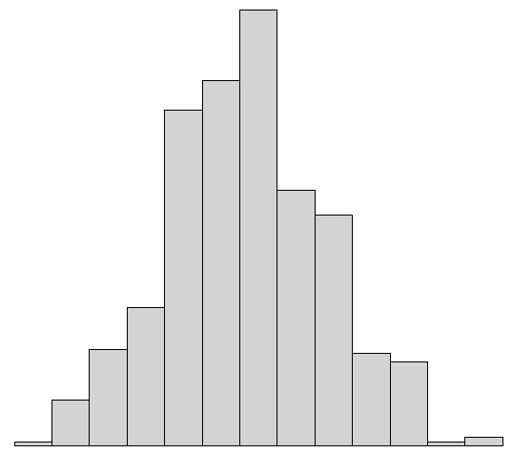
Bootstrap Salary Distributions
Bootstrapping is a computational/statistical technique that can be used to help characterize an unknown distribution by repeated sampling from an observed data set.
For example, for the Assistant Professor data, how would we expect the difference
F_Average − M_Average
to vary if we assigned the genders to the salaries at random (totally unbiased method)?
Salary | Gender
Salary 1 | M
Salary 2 | F
Salary 3 | F
. | .
. | .
. | .
Salary 46 | M
Salary | Gender
Salary 1 | F
Salary 2 | M
Salary 3 | F
. | .
. | .
. | .
Salary 46 | F
Compute Difference in Averages
$1,800
Repeat Process (many times) to Obtain Bootstrap Distribution
Randomly Assign Genders

Slide 9


Bootstrap Salary Distributions

Slide 10
Assistant Professors
Years employed (on tenure track) is not significant
Gender is not significant
Division is not significant
Less of the variance explained (R-Squared of 0.18)

Slide 11
Associate/
Full Professors
Years tenured matters more than years employed (on tenure track)
Gender is not significant
Having an endowed chair is significant
More of the variance explained than for assistant professors (R-Squared = 0.92)

Slide 12
Conclusions
When years in a tenure-track line, rank, endowed chair status, and division are included in a linear model predicting July 2022 salary, the effect of gender is not statistically significant.
When examining salary for faculty at different ranks (assistant, associate, and full), we found no statistically significant gender effects for any rank. For assistant professors, years in a tenure-track line is not a powerful predictor, but for associate/full professors it is.
We also looked for systematic differences of salary at hire, finding none, especially among faculty hired after 1995. Finally, we considered a few models that included race, citizenship status, and gender and found no statistically significant effects of any identity category on July 2022 salaries.

Slide 13
Auxiliary Slides

Slide 14
Race and Citizenship Descriptives

Slide 15
Model #1 with Race and Citizenship Status

Slide 16
Model #2 with Race and Citizenship Status

Slide 17
Analysis of Initial Salary

Slide 19
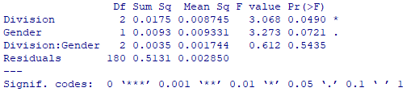



2-Factor ANOVA Analysis
Interaction is not significant
2-Factor ANOVA Analysis
Gender is marginally significant
2-Factor ANOVA Analysis for Year > 1995 Subset
Gender is not significant

